Slide 1
Learning Outcomes Assessment
Dr. Soumitra Basu
Dr. Cate Kaluzny
Notes:
Welcome to the first sessions in the series: Equipping Your Assessment Toolbox on Learning Outcomes Assessment. This session is in response to a survey conducted in 2021 where we asked faculty what topics they would like Professional Development on. Learning Outcomes Assessment was one of the most frequent topics indicated by respondents. I will begin the session with a big picture view of learning outcomes assessment and then Dr. Soumi Basu will go into more depth and talk about the practicality of the topic. We will stop for questions during our presentations but please feel free to ask questions at any point during the session.

Slide 2
Learning Outcomes for this Session
Participants will be able to identify the differences between goals, objectives, and outcomes.
Participants will be able to identify the differences between course, program, or Institutional Outcomes.
Participants will be able to utilize Bloom’s taxonomy in writing learning outcome statements.
Participants will be able to identify the main components of an effective learning outcome statement.
Notes:
On this slide are the learning outcomes for our session.

Slide 3
Goals, Objectives and Outcomes
Goals are the larger category usually relating to the larger aims such as critical thinking or creativity.
Objectives are what an instructor puts into the course and plans for achieving the course goals. Tied to instructional materials.
Outcomes are what learners actually produce. They explain what students will be able to do because of the instruction, analysis , or discussion. Learning outcomes are measurable and observable. Tied to student work.
Notes:
We lay out within these goals as a map we will achieve these goals.
We lay out objectives within these goals as map to how we can achieve these goals. While the objectives focus on what the teacher does (and they can sometimes read very similarly to outcome, Outcomes focus on what students will be able to do at the end of the course, program, or experience an an institution.

Slide 4
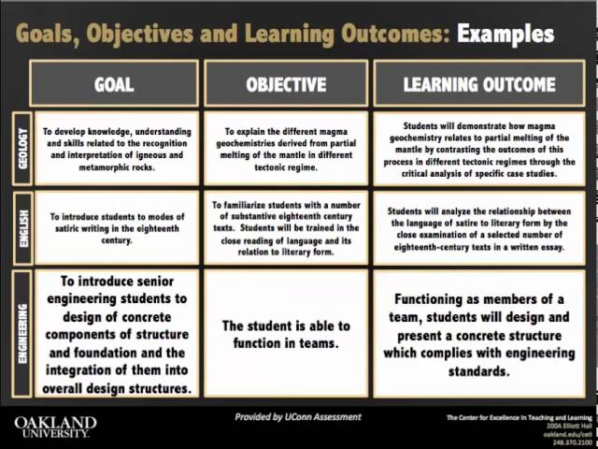
Notes:
As you move from left to right you can see the statements becoming more concrete.

Slide 5
Institutional Outcomes
Institutional Outcomes are Broad statements which represent the values of an institution. Institutional outcomes are grounded in the University’s mission. Institutional outcomes provide guidance to departments for the development of program outcomes.
Institutional Learning Priorities (ILPs)
What students know, are able to do, and value upon graduation from Fitchburg State University
Through their complete educational experience, Fitchburg State graduates will be creative and critical thinkers who integrate and communicate their learning from a variety of disciplines and experiences in ways that enhance their civic, personal and professional lives.
Notes:
They focus on the abilities and knowledge and skills that students develop from their engagement in the university experiences including courses, co-curricular activities, institutional activities, student services, and other experiences.

Slide 6
Program Learning Outcomes
Program Outcomes are mapped to the institutional outcomes and show how students achieve institutional outcomes in that academic program. Program outcomes emphasize the specific knowledge, skills, and dispositions students can expect to achieve upon completion of a particular course of study.

Slide 7
Course Learning Outcomes
Course outcomes articulate what students will know and be able to do as a result of taking the course. Course outcomes are more specific than program outcomes. They are mapped to the program outcomes, and can be thought of as building blocks to help students achieve program outcomes.

Slide 8
Structure of Learning Outcome Statements
Begin with an action verb that corresponds to the level of learning you are hoping your students achieve.
Terms such as know, understand, learn, appreciate are generally not specific enough to be measurable. Levels of learning and associated verbs may include the following:
Remembering and understanding: recall, identify, label, illustrate, summarize.
Applying and analyzing: use, differentiate, organize, integrate, apply, solve, analyze.
Evaluating and creating: Monitor, test, judge, produce, revise, compose.
Notes:
The central element to learning outcomes assessment is the development of outcome statements. Now let’s look at an interpretation of Bloom's Taxonomy to see how the verbs are arranged.Terms such as know, understand, learn, appreciate are generally not specific enough to be measurable.

Slide 9
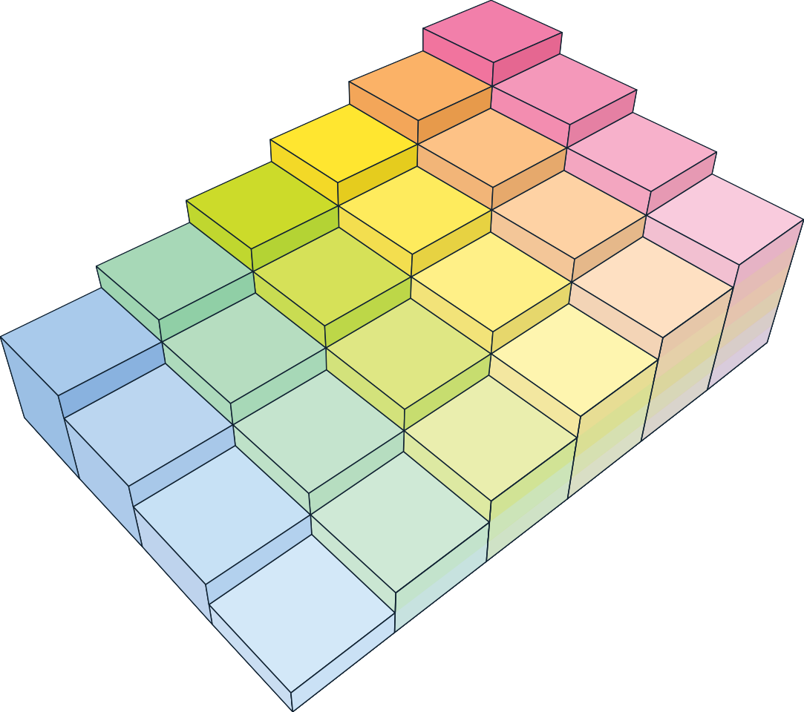
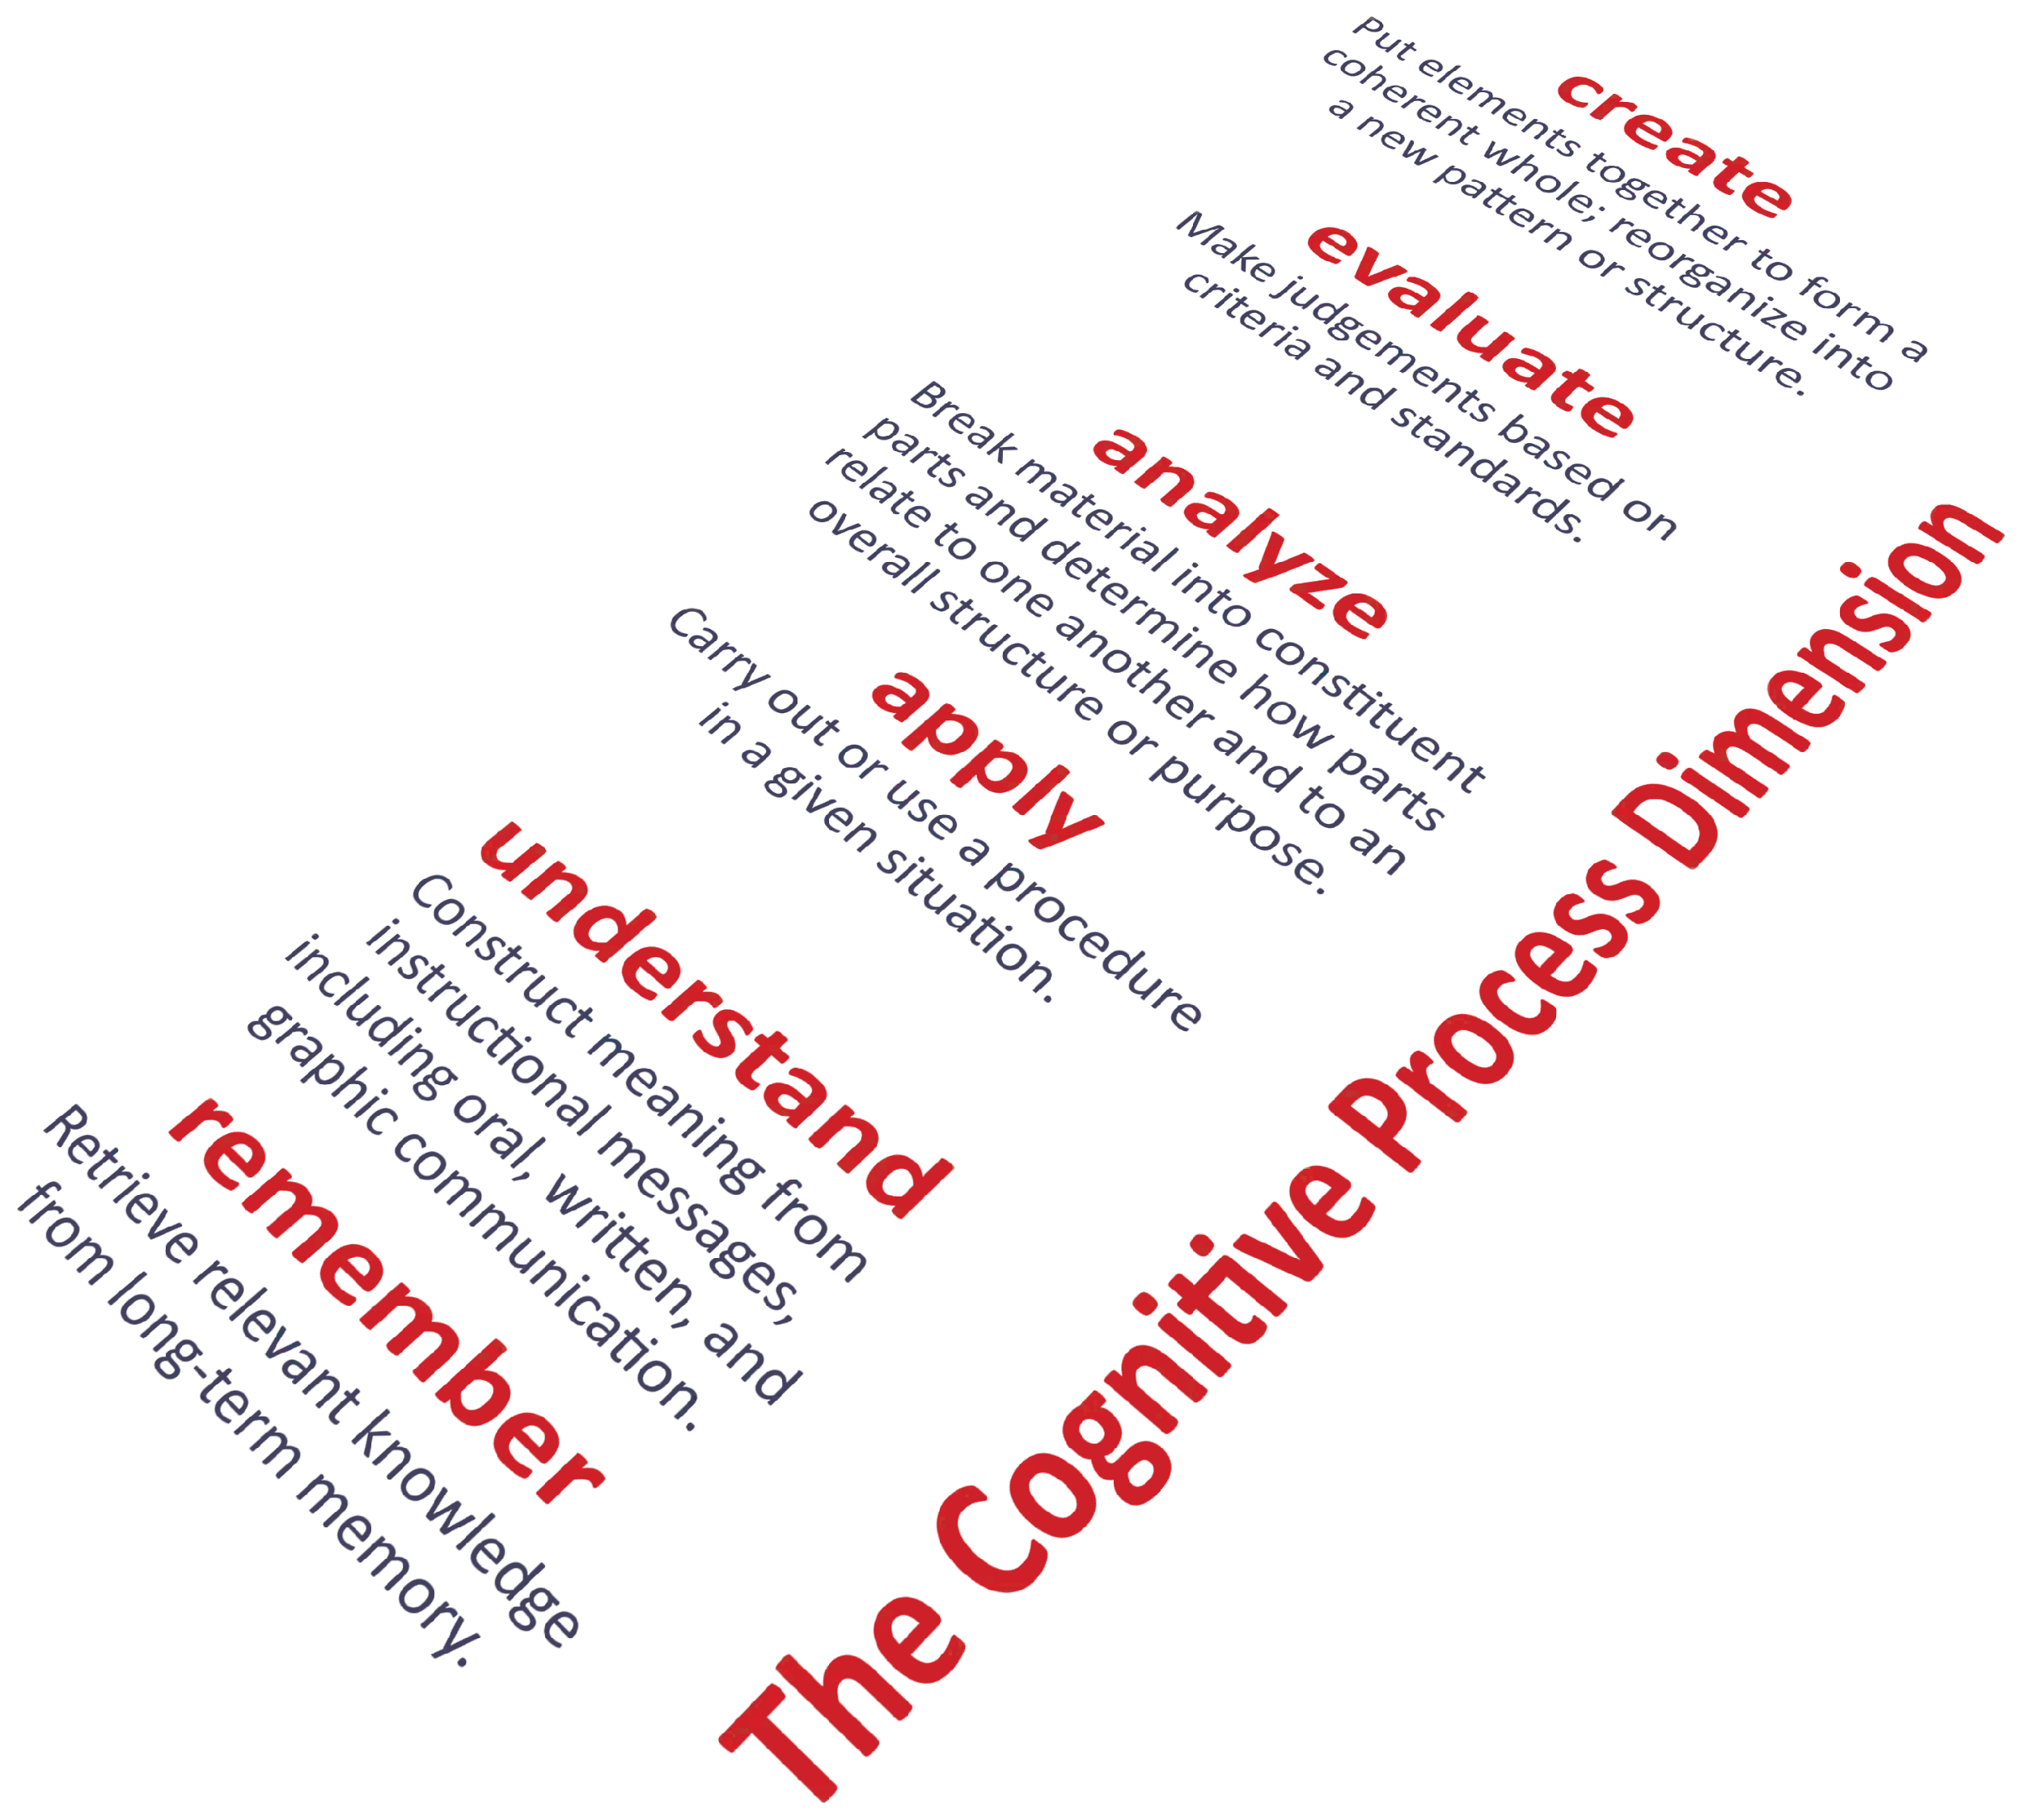
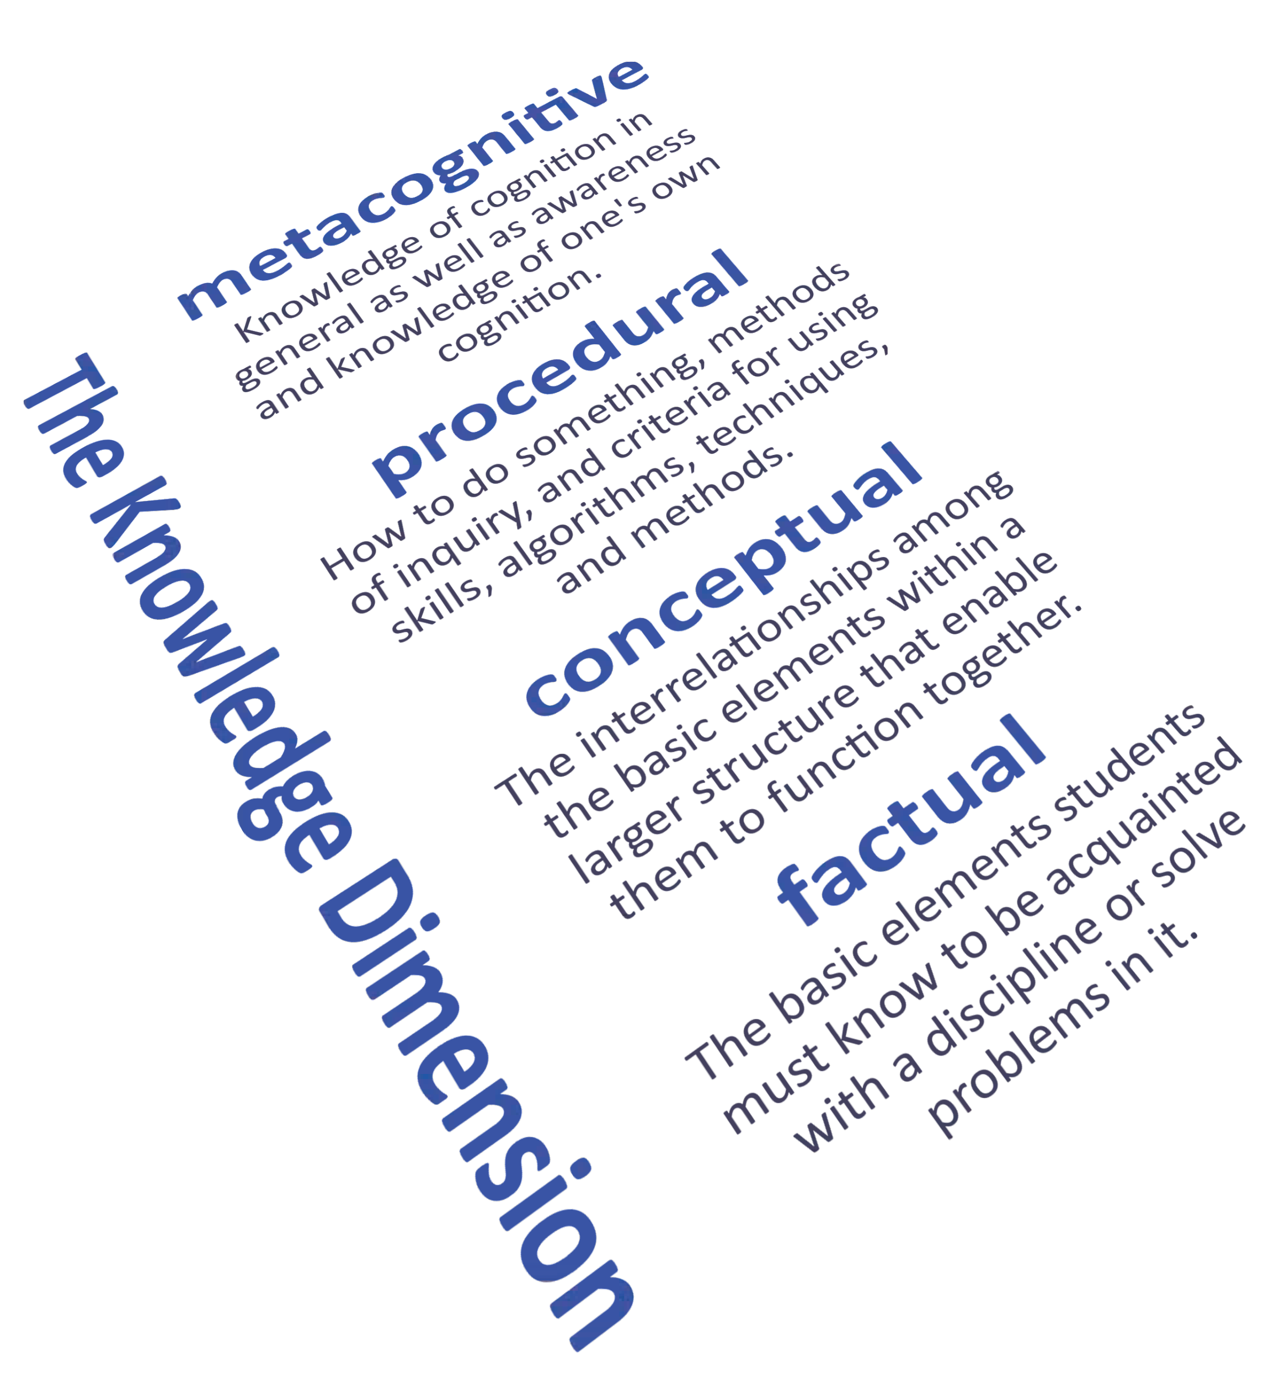

Create
an innovative learning portfolio.
Reﬂect
In this model, each of the colored blocks shows an example of a learning outcome that generally corresponds with each of the various combinations of the cognitive process and knowledge dimensions.
Design
on one’s progress.
an eﬃcient project workﬂow.
Deconstruct
one’s biases.
Judge
eﬃciency of sampling techniques.
Assemble a team of experts.
Remember: these are learning outcomes—not learning activities.
It may be useful to think of preceding each objective with something like: “Students will be able to . . .”
Use
techniques that match one’s strengths.
Integrate compliance with regulations.
Determine relevance of results.
Generate a log of daily activities.
Predict
one’s response to culture shock.
Carry out
pH tests of water samples.
Diﬀerentiate high and low culture.
Check
for consistency among sources.
Identify
strategies for retaining information.
Clarify assembly instructions.
Provide advice to novices.
Select
the most complete list of activities.
Recall
how to perform CPR.
Classify adhesives by toxicity.
Respond
to frequently asked questions.
Recognize symptoms of exhaustion.
Summarize features of a new product.
List
primary and secondary colors.
Model created by: Rex Heer Iowa State University
Center for Excellence in Learning and Teaching Updated January, 2012
Licensed under a Creative Commons Attribution- NonCommercial-ShareAlike 3.0 Unported License. For additional resources, see:
www.celt.iastate.edu/teaching/RevisedBlooms1.html

Slide 10
The statement should describe the knowledge and abilities to be demonstrated.
For example: Students will be able to
•Identify and summarize the important feature of major periods in the history of western culture.
•Apply important chemical concepts and principles to draw conclusions about chemical reactions.
•Demonstrate knowledge about the significance of current research in the field of psychology by writing a research paper.

Slide 11
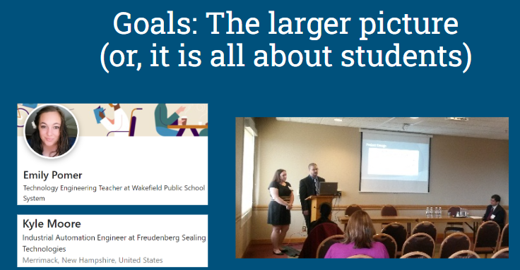

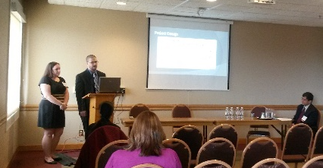
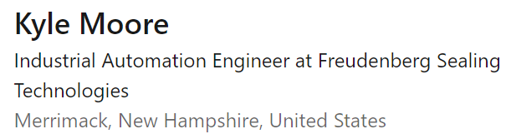
Goals: The larger picture
(or, it is all about students)
I

Slide 12


Awareness and some knowledge of the goals of the State and the University
Massachusetts
Fitchburg State

Slide 13
State Mission
... Massachusetts residents have the opportunity to benefit from a higher education that enriches their lives and advances their contributions to the civic life, economic development, and social progress of the Commonwealth
Massachusetts

Slide 14
University Mission
.. leadership and support for the economic, environmental, social, and cultural needs of North Central Massachusetts and the Commonwealth
Fitchburg State

Slide 15
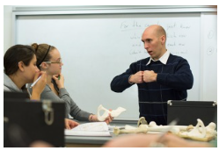
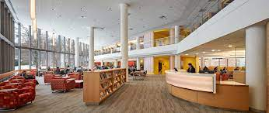
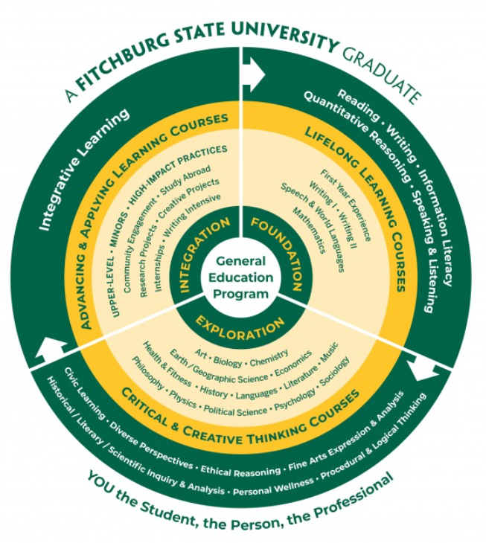


The Academic Facet of the
University Mission is supported by ...
Schools
Gen.Ed.
First Year
Learning from Local & Global Community
Library

Slide 16
Goals: The larger picture
Department of Higher Education
Goals
Massachusetts
Fitchburg Univ.
Objectives & Outcomes
Civic
enrichment
Economic Development
Economic Development
Environmental, Social, Cultural Needs (cultivating the mind)
Example
Social Progress

Slide 17
School Goals (Mission)
Example: Health & Natural Sciences
Goals
Objectives & Outcomes
..help students develop the skills and habits of mind necessary for scientific inquiry and analysis in their professional, personal and civic lives
Example

Slide 18
Goals: The larger picture
Department of Higher Education
Goals
Massachusetts
Fitchburg Univ.
Health & Natural Sciences
Objectives & Outcomes
Civic
enrichment
Economic Development
Habits of mind for scientific inquiry & Analysis
Economic Development
Environmental, Social, Cultural Needs (cultivating the mind)
Example
Social Progress

Slide 19
Program
Example: Goals of the Engineering Technology Program
Goals
Objectives & Outcomes
..innovative in problem solving, understand the inherent value of design, have high ethical standards, are skilled in communication, are cognizant of their responsibility for a sustainable future, and are responsive to change.
Example

Slide 20
University, School & Program Goals
Goals
Fitchburg Univ.
Health & Natural Sciences
Engineering Technology P.
Objectives & Outcomes
Economic Development
Habits of mind for scientific inquiry & Analysis
Innovative & agile problem solvers, understand design, sustainability
Environmental, Social, Cultural Needs (cultivating the mind)
Example

Slide 21
Objectives and Outcomes
Goals
CONTENT: What is being taught
GOAL: Why is it being taught
OBJECTIVES Advance towards the GOAL with “bite sized to-do items” or assessible objectives.
OUTCOMES: Assess the objectives by checking outcomes (what the student is able to do at the end of the course) addressing one or more “Key performance indicators” or KPI’s
Objectives & Outcomes
Example

Slide 22
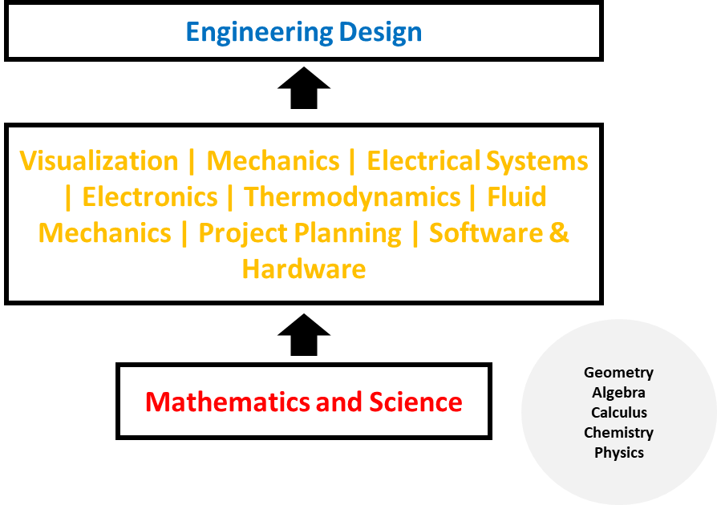
Objectives and Outcomes
addressed by
Program Content
Goals
Objectives & Outcomes
Example

Slide 23
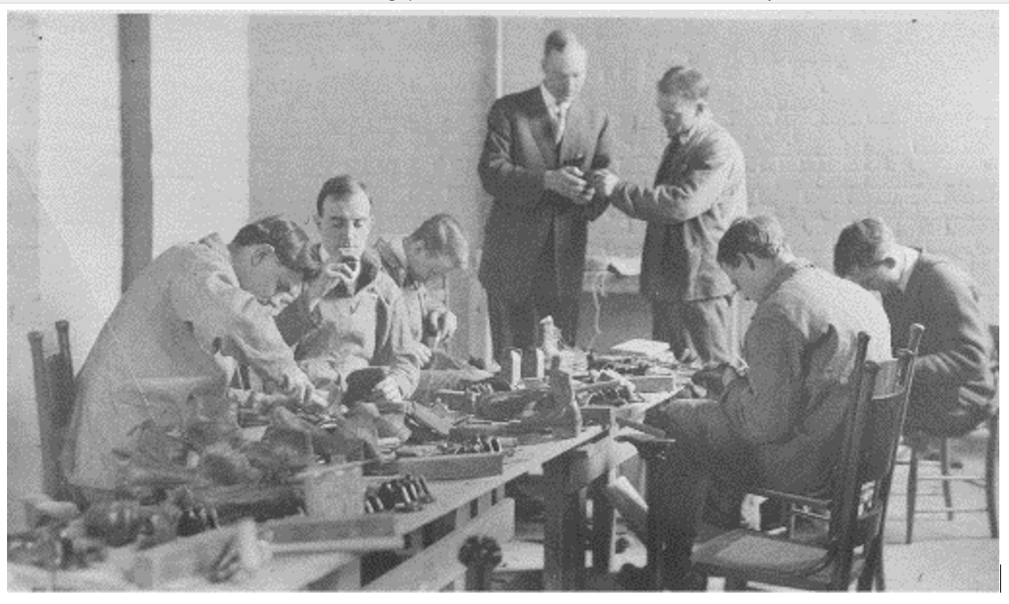
Objectives and Outcomes
&
Program Assessment
Goals
Objectives & Outcomes
Accrediting Body Standards
Goal & Content
Example
What are students being taught and why?

Slide 24
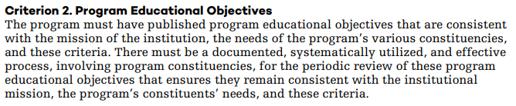
Objectives and Outcomes
ABET Objectives
Goals
ABET
Objectives & Outcomes
Example

Slide 25
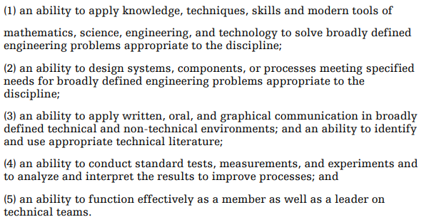
Objectives and Outcomes
ABET Outcomes
Goals
ABET
Objectives & Outcomes
Example

Slide 26
Objectives and Outcomes
Program Content
Goals
ABET & FE
Objectives & Outcomes
Engineering Design
Project Planning
Software & Hardware
Example
Thermodynamics
Electronics
Fluid Mechanics
Visualization
Mechanics
Electr. Systems
Science and Mathematics

Slide 27
Creating Learning Outcomes

Slide 28
“Bloom’s Taxonomy”
( ) Create
( ) Evaluate
( ) Analyze
( ) Apply
( ) Understand
( ) Remember
Cognitive
[Baseline Course]
[Credits]
( ) Naturalization
( ) Articulation
( ) Precision
( ) Manipulation
( ) Imitation
Psychomotor
[Baseline Course]
[Credits]
( ) Characterizing
( ) Organizing
( ) Valuing
( ) Responding
( ) Receiving
Affective
[Baseline Course]
[Credits]

Slide 29
Example
From Objectives to Outcomes
Goals
Objectives & Outcomes
Starting with the Learning Objectives, determine the “level” at which the student is expected to perform
Think of what student artifact (this depends on the content of the course. for example, in a communications heavy course one may look at presentation performance)
Identify key Learning Indicators. Best to keep 1 to 3 KPI’s per Outcome
Example

Slide 30
Example:
Applying Bloom’s Taxonomy
to Learning Outcomes
Goals
Objectives & Outcomes
Outcomes
Identify Key Performance Indicators
..Remember?
..Understand
.. Apply?
..
Foundational? Intermediate? Integrative?
Objectives
Example
Prerequisites

Slide 31
From Objectives to Outcomes and performance indicators
Example:
Goal: Foundational concepts in Thermodynamics
Learning Objective: Students will be able to apply the Zeroth, First and Second Laws of Thermodynamics.
Learning Outcome: Students will be able to compute the relation between energy supplied, change in internal energy and work done
Performance Indicator: A numerical problem on the work done by a gas-filled system when it is heated.

Slide 32
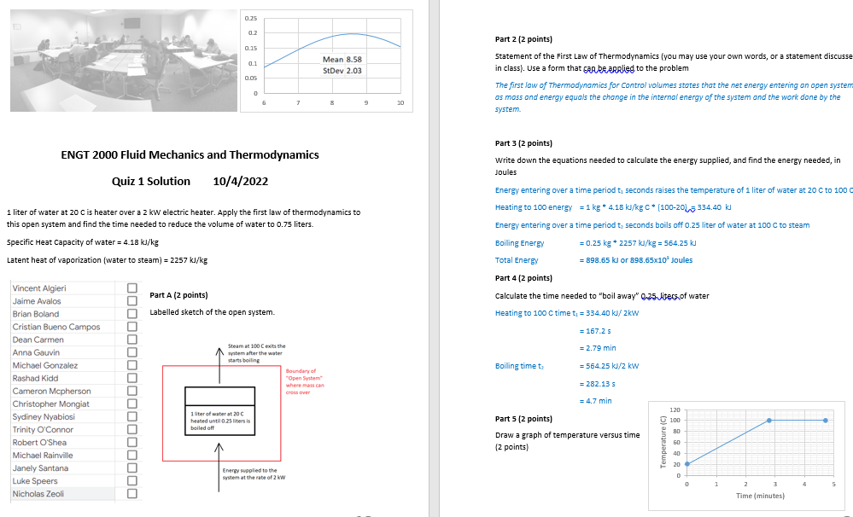
Example
Goals
( ) Create
( ) Evaluate
( ) Analyze
( ) Apply
( ) Understand
( ) Remember
Cognitive
[Baseline Course]
[Credits]
Objectives & Outcomes
Example

Slide 33
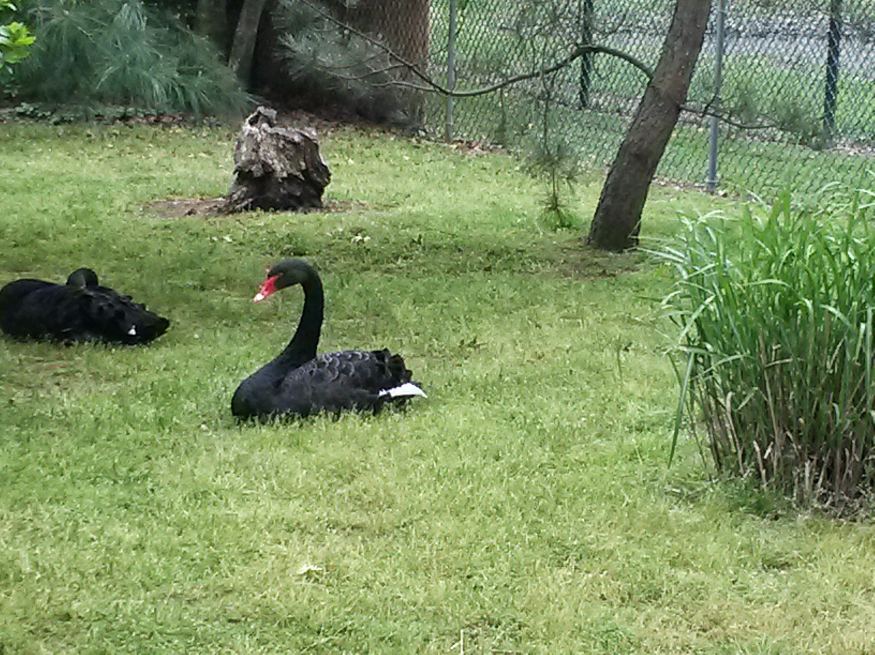
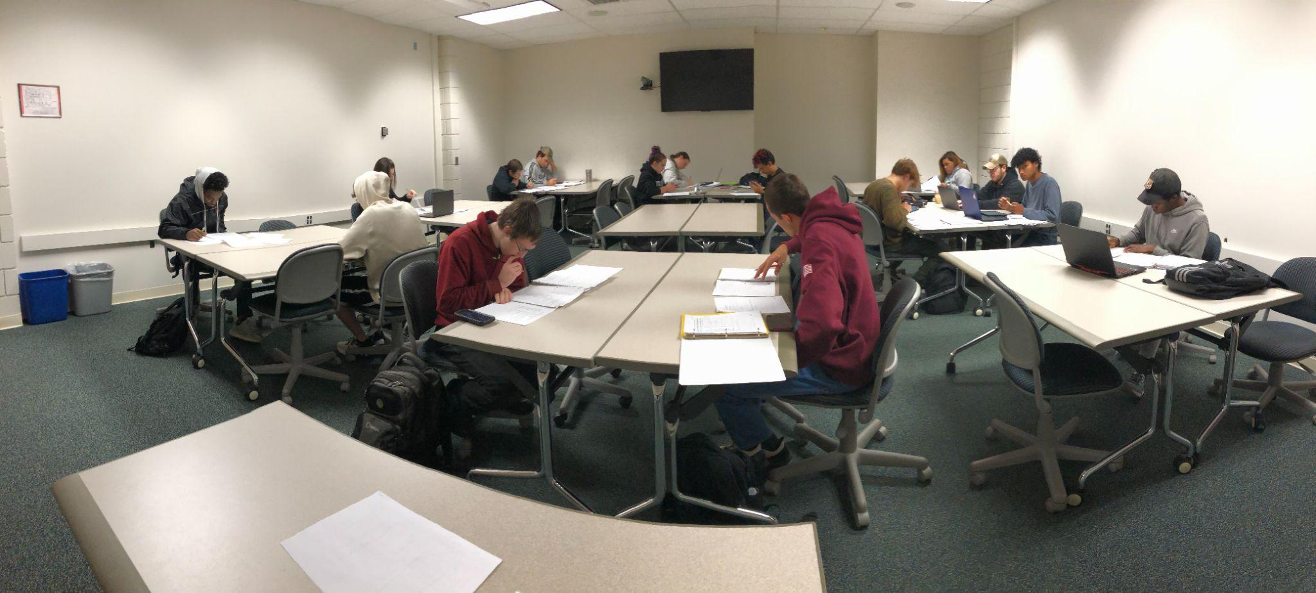
The Students are our future.
They are all “different”
They need our faith and effort
Goals
Objectives & Outcomes
Example

Slide 34
Questions?

