Slide 1
Microaggressions in The Classroom
Dr. Lyndsey Benharris and Dr. Danette Day
Assistant Professors, Education Department
Notes:
John Legend, The Roots - Wake Up Everybody ft. Melanie Fiona & Common: https://www.youtube.com/watch?v=iJgxJ6JrPkc

Slide 2
Learning Goals for this session...
1. Discuss racial/gender consciousness
2. Define and name some microaggressions in the classroom
3. Determine one’s role in the communication of microaggressions
Perpetrators
Targets
Bystanders
4. Develop skills to combat microaggressions
Make the ‘Invisible Visible’
Facilitate Discussion
Create Safe Spaces for Marginalized Groups
Share Power and Undue Privilege
Promote Equity and Social Justice within your ‘Sphere of Influence’

Slide 3
Racial Consciousness
Use the index card provided to answer the following question.
Given the following racial identities, which one would you choose if given the opportunity to change your current identity? List three reasons for your choice.
Asian American/Pacific Islander
Black/African American
Latinx/Hispanic American
Native American
White
*If you choose to maintain your current identity, indicate three reasons why.
Notes:
Pair Share Activity
Ask for people to share their thoughts about the activity. What did you experience? Why do you think we asked you to engage in this activity?

Slide 4
Microaggressions...
Have you ever heard of microaggressions?
Have you ever been involved in communication that you would label as microaggressions? If so, what role did you play in the microaggressions?
When involved in a microaggression did you feel equipped to effectively respond? Why or why not?
Notes:
Pose Questions to Full Group. Ask for Popcorn Responses

Slide 5
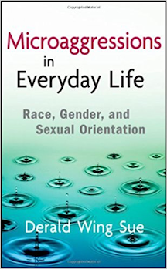
Taxonomy of Microaggressions
Microaggressions are “brief and commonplace daily verbal, behavioral, and environmental indignities, whether intentional or unintentional, that communicate hostile, derogatory, or negative racial, gender, sexual-orientation, and religious slights and insults to the target person or group (Sue, Capodilupo, et. al., 2007).
Notes:
Lyndsey read

Slide 6
Types of Microaggressions
Microassaults - Conscious, deliberate, subtle or explicit attitudes, beliefs, or behaviors toward marginalized groups through cues, words or behaviors.
Microinsults - Often unconscious communications that convey rudeness and insensitivity and demean a person’s racial heritage.
Microinvalidations - Often unconscious communications that exclude, negate, or nullify the psychological thoughts, feelings, or experiential reality of a person of color.
Sue, Capodilupo, et. al., (2007)
Notes:
Danette reads: Microaggressions usually manifest in the following ways and communicate either overt, covert or hidden offensive messages and meaning to the recipients.
Lyndsey passes out sheet with definitions.

Slide 7
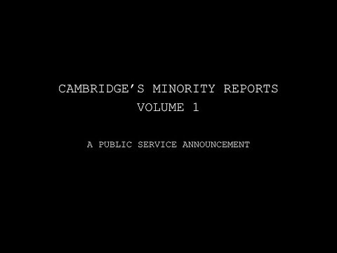
Microaggressions in the Classroom

Slide 8
Unpacking Cambridge’s Minority Report
Write down one experience a student described that resonated with you and/or offended you.
What type of microaggression would you label the experience?
Discuss with a partner the following:
What resonated with you?
Why were you offended?
After learning of these students’ experiences, in what ways might you acknowledge, influence, and improve their experiences?
If one of these situations happened in your classroom, what would you do?
What might you be afraid to do? Why?
Notes:
Lyndsey and Danette facilitate together.

Slide 9
Combating Microaggressions...
Make the Invisible Visible: If microaggressions remain hidden, invisible, unspoken and excused as innocent slights with minimal harm, we will continue to insult, demean, alienate, and oppress marginalized groups.
We must be aware of our own values, biases, and assumptions about our students and ourselves. According to Sue (2010) we must constantly ask ourselves the following questions: What does it mean to be White, Black/African American, Asian American/Pacific Islander, Latinx/Hispanic American, or Native American?
Facilitate Dialogue: We must reach a working level of critical consciousness. We must possess a working definition and enlightened understanding of the cases, manifestations, and dynamics of racial microaggressions to engage in difficult dialogues on race.
Create Safe Spaces: Be open with your students about your intentions to interrupt microaggressions so all students may feel safe and comfortable enough to learn in your classroom. Be honest about the work being difficult.
Share the Power: Be humble tell students of your insecurities and fear. Encourage students to teach you and to teach one another.
Find the Courage to Promote Social Justice and Equity: Spend your Privilege: Use your Sphere of Influence
Notes:
Facilitating dialogue, According to Sue (2010) we must “possess a working definition and enlightened understanding of the cases, manifestations, and dynamics of racial microaggressions and difficult dialogues on race.” This can be difficult as we, as professors, have a significant amount of power. These power dynamics can make it difficult to move forward in a tense dialogue.

Slide 10
Classroom Scenario:
Control The Process Not The Content
How would you respond if these statements were made during a heated debate in your classroom?
Before class a student declares: “We Italians experienced severe discrimination when we arrived here. Did my family harp on the prejudice? We excelled despite the prejudice. Why? Because the basic founding principles of this country made it possible!”
1. Acknowledge the accuracy of statements when appropriate.
2. Intervene in the process rather than the content.
3. Help students see the difference between intention and impact.
4. Move to the feeling tone level of the communication.
Notes:
1. Don’t get into a debate
2. Hearing other people’s realities
3. What are your intentions versus

Slide 11
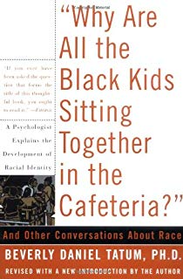

For over 20 years, Tatum’s Why Are All the Black Kids Sitting Together in the Cafeteria: And other conversations about race. has been used to educate and promote healthy discussions among young people about race. We can no longer be Color Silent. Dr. Beverly Tatum https://www.youtube.com/watch?v=l_TFaS3KW6s
Dr. Beverly Tatum wrote the book to help others move beyond fear, anger and denial to a new understanding of what racism is, how it impacts all of us and ultimately what we can do about it. She wanted to inspire readers to break the silence about racism and to use their spheres of influence to effect positive social change. In 2017 she revised and release a 20th anniversary edition of the book.
Notes:
Tatum (2017) states, “because of persistent K-12 school segregation, colleges and universities are among the few places where people of different racial, cultural and socioeconomic backgrounds can engage with each other in more than just a superficial way. However, because of both lack of direct contact and repeated exposure to cultural stereotypes while growing up, cross-group interactions can be uncomfortable. Even genuine efforts at friendship and connection can be derailed by awkward interactions and unconscious bias. Ideally, the college years offer a unique opportunity to engage with people whose life experiences and viewpoints are different than one’s own and to develop the leadership capacity needed to function effectively in a diverse, increasingly global, world. However, whether college students develop that capacity will depend in large part on whether the institution they attend has provided structures for those learning experiences to take place. Intentionality matters.

Slide 12
The Impacts
“Countless examples of microaggressions are delivered daily without awareness of perpetrators. And while these actions may appear harmless or innocent in nature, they are nevertheless detrimental to recipients because they result in harmful psychological consequences and create disparities. Microaggressions sap the spiritual energies of recipients (Pierce, 1995), lead to low self-esteem (Franklin, 2004), and deplete or divert energy for adaptive functioning and problem solving (Dovidio & Gaertner, 2000).
https://www.youtube.com/watch?v=C3LFB4mJ0DI
Notes:
The following adapted passage, for example, indicates how microaggressions affect Don Locke, an African American” (Sue, 2010, p. 15).

Slide 13
Thank you! Any Questions?
Brief Exit Ticket
What did you know about microaggressions prior to this session?
What new information did you learn today?
What additional information would like to learn?
What, if any, new strategies did you learn that you can apply to address microaggressions in the classroom?
Notes:
Imagine, John Lennon: https://www.youtube.com/watch?v=b7MMPQJMw20

