Slide 1
Examining Prismatic Learning: Exploring Intersections of Assessment, Equity, and Culturally Responsive Practices
Natasha Jankowski, PhD
Executive Director, National Institute for Learning Outcomes Assessment (NILOA)
Research Associate Professor, University of Illinois Urbana-Champaign
@NILOA_Web
@njankow
Notes:
We look at it like something flat
But more like a prism
Depending on where we shine a light depends on what we see

Slide 2
National Institute for Learning Outcomes Assessment (NILOA)
NILOA is a research and resource-development organization dedicated to documenting, advocating, and facilitating the systematic use of learning outcomes assessment to improve student learning.

Slide 3
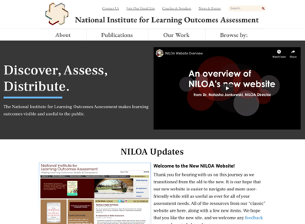
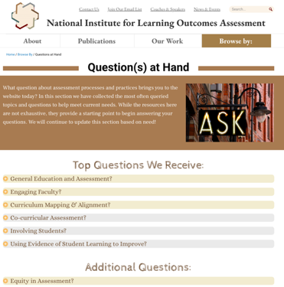
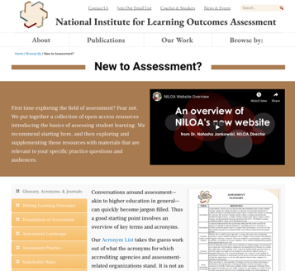
www.LearningOutcomesAssessment.org
Notes:
New website – learningoutcomesassessment.org
Assessment modules
Assessment brief and audiences
Join our email list – newsletter coming out today

Slide 4
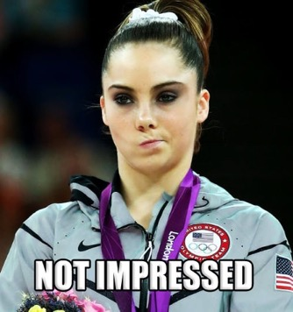
Notes:
Know we are all tired, and maybe not overly excited to talk about assessment

Slide 5
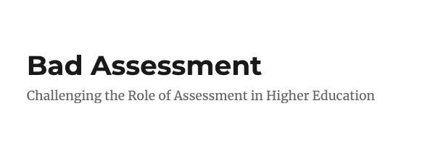
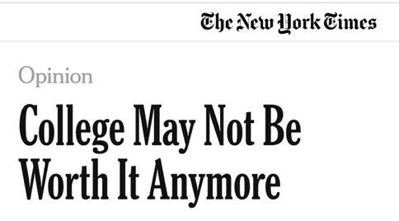
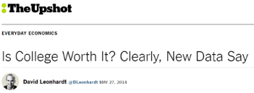
The current state of the field…
Notes:
And you aren’t alone, lots of thoughts on assessment – what it is and what it isn’t

Slide 6
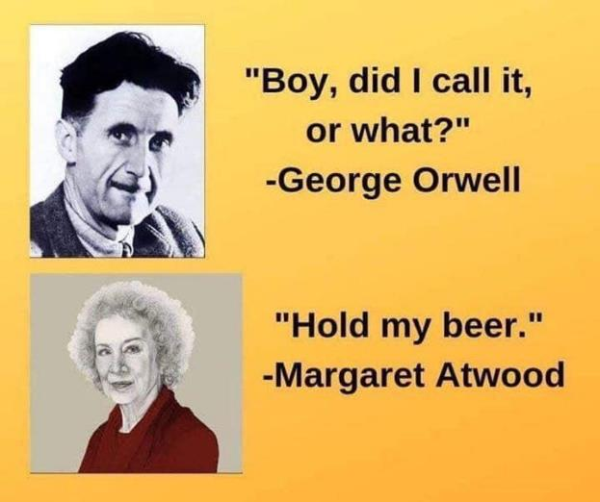
Notes:
And this just makes me giggle, so it’s going in the slides.
Not the only thing that is going on in the world that’s crazy

Slide 7
Assessment
Assessment of student learning involves the systematic collection, review, and use of information about educational programs undertaken for the purpose of improving student learning and development.
It does not mean testing or grading only
It is a discipline and scholarship
It is not only done because someone said we had to
Notes:
Let’s get on the same page with a bit of a definition of what assessment is and isn’t

Slide 8
Notes:
Need to trouble and make this more complex – talk about it like there is one way to do it – but as a discipline, there are debates within about how to do it, etc.

Slide 9
Three Schools of Thought
Measurement
Compliance (Reporting)
Teaching and Learning (Improvement)

Slide 10
Measurement
Built upon scientific principles or empirical research, objective, rational, validity, and reliability
The Multi-State Collaborative: A Preliminary Examination of Convergent Validation Evidence ~Mark Nicholas, John Hathcoat, & Brittany Brown
Testing and standardization
Must be measureable
Argue narrowing of curriculum
Goal driven
Focused on process
Interventions
Pre/post
Comparisons
Notes:
Yeah that sounds great, but your n is too small
Sure these results could be actionable, but how did you collect the datat?
Folks that think assessment is about testing
Standardization
Also belief that if we get a process in place it will somehow protect us, follow the process and we will be ok – as an end in itself

Slide 11
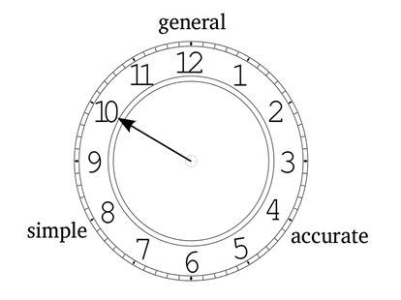
Thorngate’s Postulate of Commensurate Complexity
Represented by Weick’s clock metaphor
Notes:
Trade-offs in what we can and can’t say with theories of learning, measures, and the like

Slide 12
Compliance
Documenting institutional quality assurance through reporting frameworks
Is assessment destroying the liberal arts? ~Karin Brown
Bureaucratic
Laborious
Time consuming
Separated from teaching and learning
Add on
Accountability and quality assurance
Reporting and archive
Lots of data collection, minimal use

Slide 13
Write Outcomes
Identify Assessments
Gather Results
Package Results
Submit Reports
ACCREDITATION/ PROGRAM REVIEW
Notes:
Our reports rarely have a specific audience

Slide 14
Notes:
If that is where you are, we have a book for you! 2015 senior scholars moving from compliance to improvement
And we are pleased today to be adding another book to your repertoire of books that will change your life and practice ☺

Slide 15
But where are the students…and what does this have to do with my teaching?

Slide 16
Teaching and Learning
Focus on pedagogy, understanding of student experience, informing program improvement, embedded in curricular design and feedback, builds student agency
Does continuous assessment in higher education support student learning? ~Rosario Hernandez
Driven by faculty questions regarding their praxis – is what I am doing working for my students?
Improvement oriented
Focus on individual students
Students as active participants – not something done to them
Formative
Feedback
Collaborative
Assessment for learning
Adaptive and embedded
Notes:
A view with learning in mind is that of teaching and learning

Slide 17
Name Expectations for Learning
Communicate Expectations to Learners
Collect Student Work
Determine Extent of Learning
Strategize New Student Success Plans
IMPROVEMENT/ STUDENT SUCCESS

Slide 18
Institutional or Program Improvement
Notes:
These philosophies of assessment lend themselves to particular types of models for how we go about assessing student learning
One is not more ”right” than another – depends on background, what need to know and the like – two most prevalent that are easy to discuss are these

Slide 20
Learning Improvement

Slide 22
Ask yourself:
What do you want to know about x?
What argument do you want to make about x?
What type of evidence would be necessary to make that argument?
Notes:
But in any model you pick, ask yourself

Slide 23
The Why: Argumentation
Toulmin (2003)
Notes:
Because where we go astray is in not thinking thorugh the warrant
Instead of outlining a theory of change, engaging in root cause analysis…we can think of warrant and arguments
What we are doing, is selecting a variety of evidence, which may change depending on the audience, and providing that in relation to a claim made about improvement of student learning. The warrant involves outlining and justifying why we think this change, for these students, at this institution, at this time, led to the improvement we are seeing in student learning. Or why we think it will.
What are we seeing in practice?

Slide 24
Which means…
“Educational assessment is at heart an exercise in evidentiary reasoning. From a handful of things that students say, do, or make, we want to draw inferences about what they know, can do, or have accomplished more broadly.” (Mislevy & Riconscente, 2005, p. iv).
Put more simply it’s a way to justify stated beliefs about students and their learning as well as the role of our institutions and programs in getting them there.
Notes:
So what does that mean – well that we can think of assessment as not a measurement issue solely but one of argumentation about our effectiveness and why we do what we do for the students we have
We can think about assessment a bit differently than we may have before

Slide 25
Assessment...
Is trying to get us to think intentionally about our learning design and how it intersects with our beliefs about the purpose of education and our student population.
Notes:
It becomes a means to help us think about our design

Slide 26
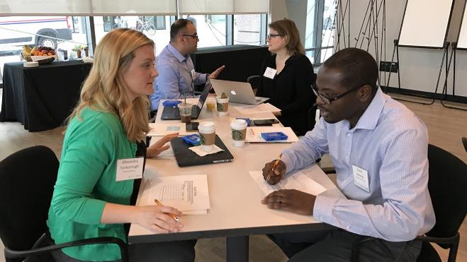
Assignments as Assessments
Faculty are working to create a curriculum that intentionally builds in integrated learning opportunities over time for students to apply and practice as well as transfer their knowledge and skills through assignments, in and out of courses – through charrettes.
Notes:
Assignments as assessments – what can be done in one assignment where else to look or partner
Not everything can be done in one, most things need to build
One place where we are seeing people think and will talk more about in the deep dive

Slide 27
What’s a“charrette”?
"Charrette" (Fr.) means a small cart. Because architecture students once deposited their assignments in it as the cart was rolled through the studio, architects now use the word to refer to an intense creative effort in a limited time period.
Sounds way cooler than an assignment design workshop.
Notes:
We did this work through a charrette

Slide 28
Assignment Design
Assignment
Scaffolding Learning
Evaluative Criteria
Learning Outcomes
Notes:
Assignments as assessments – what can be done in one assignment where else to look or partner

Slide 29
How assignments connect
Assignment
Scaffolding Learning
Evaluative Criteria
Learning Outcomes
Assignment
Scaffolding Learning
Evaluative Criteria
Learning Outcomes
Assignment
Scaffolding Learning
Evaluative Criteria
Learning Outcomes
Notes:
How connect or build from first to capstone

Slide 30
Program View
Assignment
Scaffolding Learning
Evaluative Criteria
Learning Outcomes
General Education
Major
Notes:
Or relation between major and gen ed

Slide 31
Transparency in Assignments
Transparency in Teaching and Learning: https://tilthighered.com/
Purpose
Skills you’ll practice by doing this assignment
Content knowledge you’ll gain from doing this assignment
How you can use these in your life beyond the context of this course, in and beyond college
Task
What to do
How to do it (Are there recommended steps? What roadblocks/mistakes should you avoid?)
Criteria
(Are you on the right track? How to know you’re doing what’s expected?)
Annotated examples of successful work
(What’s good about these examples? Use the checklist to identify the successful parts.)
Notes:
Why does this matter?

Slide 32
Notes:
And this matters because we know, we are the experts but our students feel a bit like this

Slide 33
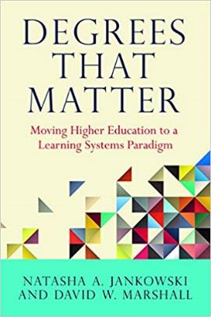
Thinking about design
Notes:
If you want a resource to help you think about design – this is a good one for you

Slide 34
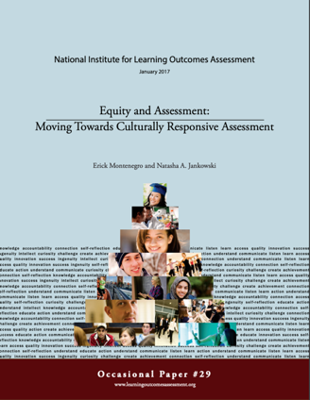
Equity and Assessment
Notes:
Want to take some time to talk about equity and assessment
There are many ways to show you know how to do something – why do only some demonstrations count in certain instances?
Don’t just validate the learner, validate the learning

Slide 35
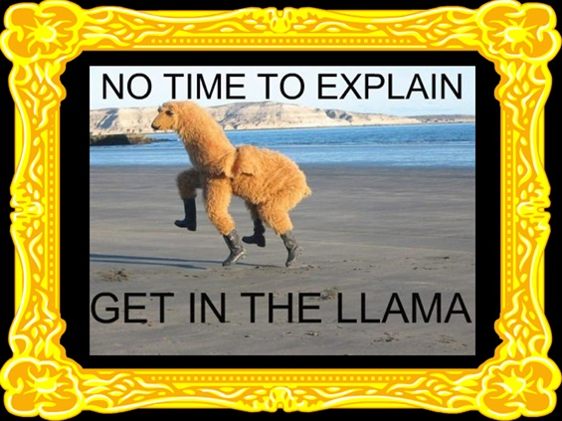
Notes:
For some students their experience is a bit like this meme

Slide 36
Notes:
This is from Ohio – let’s take a look at the structural struggles and then add a layer to it of who our students are and what they bring with them along the way

Slide 37
Fitchburg State University Students
Fall 2018 all new students About 10% part-time
Hispanic: 16% Range in age from 17-49
Black: 12% Acquiring degrees and certificates
White: 65% Part of SAM (Student Achievement
More than one: 3% Measure)
Asian: 2%
Assessment work: https://www.fitchburgstate.edu/offices-services-directory/institutional-research-and-planning/office-of-assessment/undergraduate-assessment-documentation/
Notes:
Our students today are so diverse and when they come to most of our institutions, with learning outcomes that aren’t written in language for them to understand, they experience something a bit like this

Slide 38
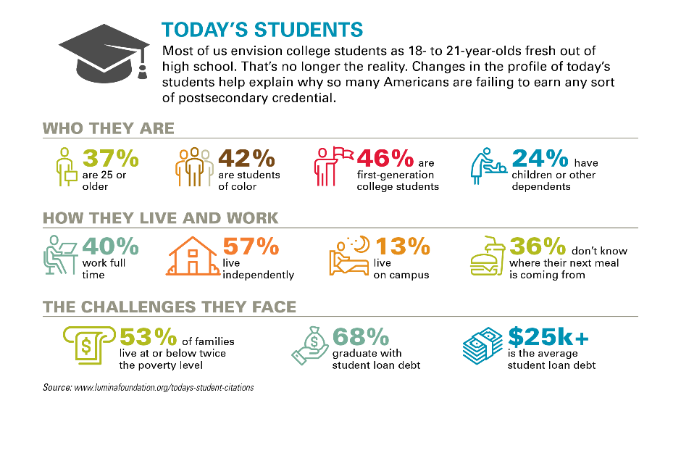
Notes:
Nationally - our students look different

Slide 39
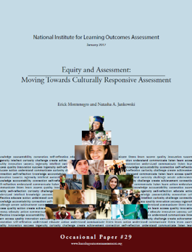
Equity Conversation Overview
Our student population is increasingly diverse
We know that in other areas of the institution, support needs differ by student populations
We don’t talk about it in assessment
We equate fairness with equity and limit the types of learning demonstrations we accept related to learning outcomes
Equity of process or equity of results?

Slide 40
Equity and Assessment
Student Roles
Assessment is not something we do to students it is something we do with students.
As a researcher
Think aloud on assignment intent
Co-create rubric
Design assignment
Bring forth evidence of learning from other sources
Validate that their learning matters
Notes:
There are many ways to show you know how to do something – why do only some demonstrations count in certain instances?
Validates our students as learners – validates them
Build from daily work of faculty in assignment, and culturally responsive assessment – equity lens added to it
Help faculty understand the diversity in front of them
Classroom teaching strategies as it relates to equity and diversity and advising lens – assignment think aloud
Have students be active researchers

Slide 41
Rubrics
Rubric Criteria | Student Evaluation | Faculty Feedback
Rubric Content | Stipulate why gave score did | Faculty stipulate why gave score did
 | Stipulate what they need to do to advance | Targeted feedback to improve
Notes:
For instance, one thing to change on the rubric is to help explore
Other tips on assignments and equity – reading aloud, etc.

Slide 42
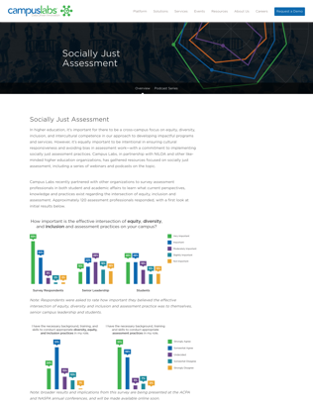
Socially Just Assessment Podcast Series
EP 1
Culturally Responsive Assessment
Critical Theory as a Framework to Advance Equity Through Student Affairs Assessment
Socially Just Assessment
Diversity, Inclusion, Equity and Assessment: Graduate School Preparation for Future Student Affairs Practitioners
The Connections between Decolonization, Social Justice and Assessment
EP 2
EP 3
EP 4
EP 5
campuslabs.com/socially-just-assessment
Notes:
If you are interested in this, there is a broad conversation unfolding in partnership with NILOA efforts

Slide 43
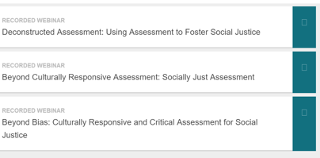

Slide 44
Closing Note on Equity
We have assumptions about our students:
Who they are
How they learn
Where they learn
What they need to succeed
All that impacts what we change and why
Notes:
Don’t assume you know without talking to the students

Slide 45
Contact Us
Email us: niloa@education.Illinois.edu
Join Our Email List: learningoutcomesassessment.org/joinemail/
Website: http://learningoutcomesassessment.org
@NILOA_web
@LearningOutcomesAssessment

Slide 46
Deep Dive Discussion
Natasha Jankowski, PhD
Executive Director, National Institute for Learning Outcomes Assessment (NILOA)
Research Associate Professor, University of Illinois Urbana-Champaign
@NILOA_Web
@njankow
Notes:
We look at it like something flat
But more like a prism
Depending on where we shine a light depends on what we see

Slide 47
Let’s Apply What We Have Learned
At your table – complete the philosophy activity sheet and discuss what it may mean among your table friends
5 minutes to complete
10 minutes to discuss
7 minutes to share more broadly
Quick note on how to do complete the form and plot on the grid.

Slide 48
Plotting Assist

Slide 49
Building from there…
What are you comfortable implementing in your classroom?
How actively involved do you want students to be?
What might a culturally responsive approach or an equity infused assessment entail?
What assignments might be a good starting point to explore?
Brainstorm at your table

Slide 50
Now consider an assignment…
Think of an assignment you give to students that doesn’t quite work as well as you would like, write down:
1. What learning outcomes are being assessed in the assignment?
2. What learning outcomes are you asking them to demonstrate in the completion of the assignment?
3. How clear is that to the students? How could it be presented in a more culturally responsive manner?
4. Does the criteria used to evaluate the assignment align with the learning outcomes being assessed?
Consider enabler learning outcomes versus those being assessed!

Slide 51
Assignment Resources

Slide 52
Contact Us
Email us: niloa@education.Illinois.edu
Join Our Email List: learningoutcomesassessment.org/joinemail/
Website: http://learningoutcomesassessment.org
@NILOA_web
@LearningOutcomesAssessment

Slide 53
Methods Conversations
Notes:
The phantom tollbooth is a great resource for having conversations about the importance of qual AND quant data

Slide 54
Courses/Experiences
Activities in courses/experiences
Assignments
Programs/General Education
Institutional
Degree
Notes:
We are seeing an attempt to bring things together holistically – we can all hear students who rush thorugh gen ed and don’t know what they were supposed to get out of it or the value, etc. Or where the real learning happened in the co-curricular and the like – point is we learn in all the places. And they should reinforce each other

Slide 55
Notes:
But that doesn’t mean there aren’t rough edges or places that are doing their own thing because it is important and of value – doesn’t mean that everything has to align up

Slide 56
Academic Affairs
 | Course 1 | Course 2 | Course 3 | Course 4
Learning Outcome 1 | X | X |  | X
Learning Outcome 2 | I | R | M
Learning Outcome 3 | Paper | Presentation | Debate | Exam

Slide 57
Student Affairs
 | Learning Experience 1 | Learning Experience 2 | Learning Experience 3 | Learning Experience 4
Learning Outcome 1 | Exposure/ Participation | Reinforce/ Development |  | Attainment/ Achievement
Learning Outcome 2 | Reflective Assignment | Presentation | Project Development
Learning Outcome 3 | Stand alone | Coupled with a course

Slide 58
Degree-Level
Learning Outcomes | General Education | Major Courses | Activities and Experience That Provide Support | Possible Careers
Learning Outcome 1 | General education courses that support the learning outcomes | Courses that address specific outcomes | Cocurricular elements that support specific outcomes | Possible career paths related to the map
Learning Outcome 2

Slide 59
Other Elements to Consider
Learning Outcomes | Prior Learning | Courses | Other Required Courses, Recommended Electives | Activities and Experience That Provide Support | Work-Based Learning Experiences | Certifications and Licensures | Possible Careers | Learner Identified
Learning Outcome 1 | Prior learning that is accepted in relation to specific outcomes | Courses that address specific outcomes | Other courses that support and reinforce specific outcomes | Cocurricular elements that support specific outcomes | Employment and other experiences that reinforce specific outcomes | Possible certifications connected to the outcomes | Possible career paths related to the map | Elements identified by learners as supporting learning outcomes
Learning Outcome 2

