Slide 1

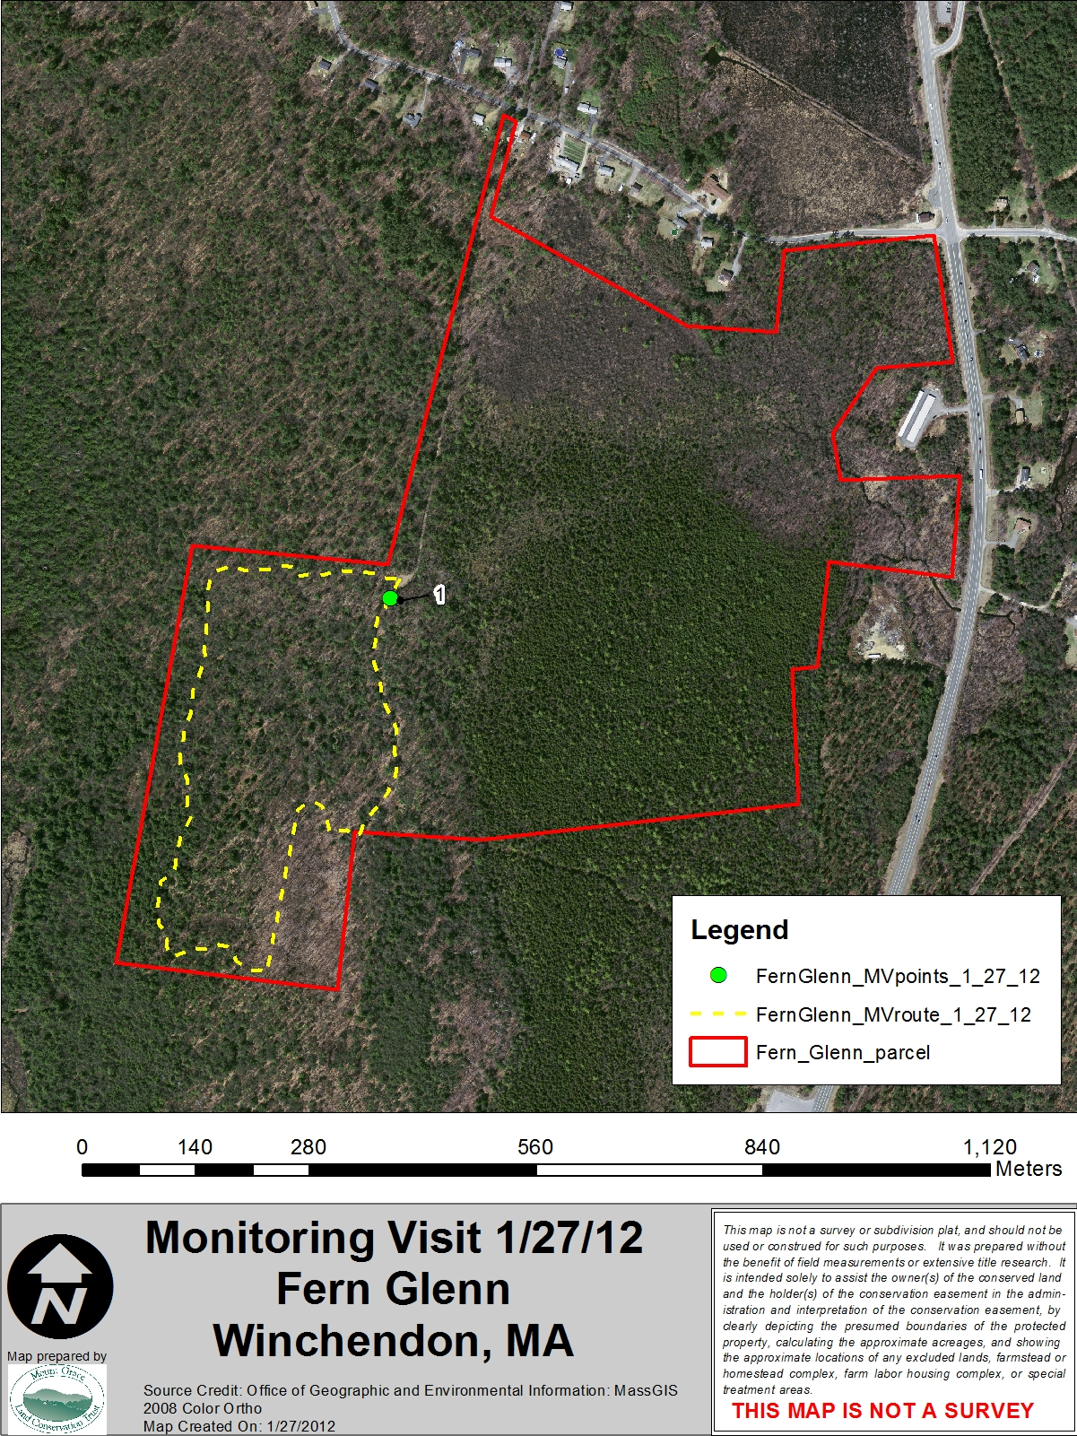
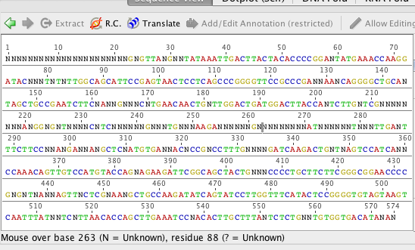
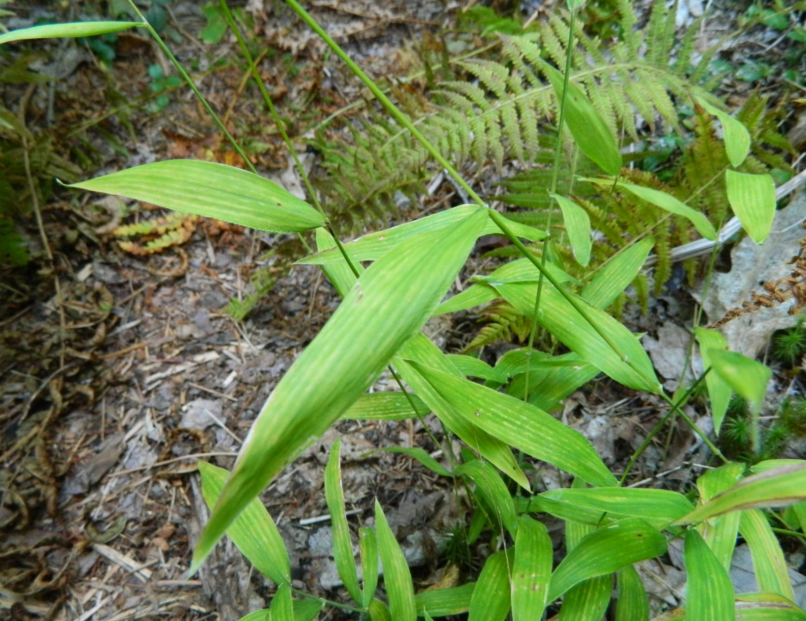

The Use of DNA Barcoding in Conducting a Plant Survey
Kyle Cormier¹, Mark Largey¹, Erin MacNeal Rehrig¹, and Davis Brush²
Dept. of Biology and Chemistry, Fitchburg State University¹, Mt. Grace Land Conservation Trust²
Abstract
The purpose of this study was to test the viability of DNA barcoding to identify plants that were otherwise unidentifiable using traditional methods due to missed flowering time or post leaf fall. We conducted a preliminary floristic inventory of the Fern Glen Conservation Area in Winchendon, MA. This is a newly established parcel in the Mount Grace Land Conservation Trust, with over 130 acres of previously unsurveyed forest. Small leaf or bud samples were collected from those plants that could only be identified only to the family or genus level. DNA was then isolated and gene-specific primers were used to amplify the chloroplastic rbcL and matK regions in Polymerase Chain Reactions (PCR). PCR products were cleaned and bi-directionally sequenced. Results were compared with the existing DNA Barcoding of Life and GENBANK databases. Positive controls, including Red Oak (Quercus rubra), were used to test the validly of the method. Our results suggest that due to incomplete libraries and unresolved issues with universal gene primers for plants, DNA barcoding may not be suitable for supplementing a traditional plant survey at the current time.
Methods: DNA Barcoding
Plant samples were frozen, pulverized in a mortar and pestle with liquid nitrogen.
DNA was isolated using Qiagen’s DNAEasy kit
We conducted 30 cycles of PCR reactions with Taq 5x Master Mix, 55°C anneal temperature, and primers:
  rbcL F:5’-ATGTCACCACAAACAGAGACTAAAGC-3’
  rbcL R:5’-GTAAAATCAAGTCCACCRCG-3’
  matK F: 5’-CCCRTYCATCTGGAAATCTTGGTTC-3’
  matK R: 5’-GCTRTRATAATGAGAAAGATTCTGC-3’
PCR samples were cleaned using a QIAquick PCR Purification Kit
Gel electrophoresis was done to detect the presence of PCR amplicons
Cleaned, amplified genes were sequenced (Fig. 2) and data were analyzed by Geneious R7 Software
Sequenced genes were BLASTed against GENBANK and DNA Barcode of Life, an on-line barcoding tool
Background of DNA Barcoding
DNA barcoding is a molecular technique used to identify species based on a certain region of an organism’s nuclear, mitochondrial, or chloroplast genome. It can be used as a practical and standardized assessment tool to assess biodiversity during ecological studies¹. In animals, the most widely used gene for DNA barcoding is the cytochrome c oxidase (CO1) gene from mitochondrial genome; in plants, it is the rbcL or matK genes from the chloroplast genomes, however, other markers have additional merit². rbcL offers high universality and decent discrimination power, but to add to the precision of identification, matK can also be used because it is a rapidly evolving coding region of the chloroplast genome with high levels of discrimination³. Combined, rbcL and matK serve as unique genes within every species that provide a quality sequence, discrimination, and low cost when being tested on plants^{2,3.}
Results
39 species within the pterophyte, angiosperm and gymnosperm sub-phyla were identified during the plant survey. Eleven out of 39 could not be positively identified using the taxonomic guides. Two additional positive controls were used including Red Oak (Quercus rubra), and Tomato (L. esculentum) to assess the accuracy of our barcoding technique.
Of the 11 unknown species, 4 were positively identified using DNA barcoding. The remaining 7 samples were unable to be resolved with this technique. Using both rbcL and matK primers, one unknown grass sample showed high probably of being a native bearded shorthusk (Brachyelytrum erectum) based on bioinformatic analysis. This was confirmed by a visual match (Fig. 3). Other wild species positively identified using bioinformatics included White Pine (Pinus strobus) and a Trillium species.
Tomato (L. esculentum) was successful as a positive control, however, Red Oak was unable to be matched using DNA barcoding. Tomato was used because it was available in our greenhouses on campus.
Methods: Plant Survey
A non-exhaustive plant survey was done along a transect on the Blue Blaze hiking trail around the perimeter of the sloped woodland and boreal swamp of Fern Glen.
Angiosperms, conifers, grasses, ferns, and mosses were examined.
Taxonomic keys used: Newcomb’s Wildflower Identification guide, A Field Guide to Trees & Shrubs (northeastern USA & southeastern Canada edition), Grasses: An Identification Guide, and Fern Finder.
Each identification included a GPS coordinate, a close-up picture, and a list of obvious traits that matched the taxonomic key.
When there was a confident identification, plants were not collected for further analysis.
If the identification was not confident, specimens were collected and underwent DNA barcode analysis unless they highly resembled plants on the Massachusetts Endangered Species List.
Figure 2: rbcL-F DNA sequence suggesting B. erectum as the collected species
Figure 3: Unknown grass sample identified as B. erectum
Discussion
Based on the results, rbcL primers had a higher success rate compared to matk primers. However the results were inconclusive, suggesting that other markers would be more suitable for DNA barcoding across multiple plant phyla.
Gel electrophoresis showed a lack of clear amplicon bands in any lanes. In some samples, there was enough PCR product for sequencing, but this suggests that the PCR reactions were not robust, likely due to poor primer hybridization.
Papadopoulou et al. 2013 found new target markers for plant barcoding (psbA-trnH), which will be used in future studies.
No invasive or foreign species were identified in the conservation area. This suggests the area is undisturbed and fairly pristine as a conservation area.
This project provided Mt. Grace with valuable survey information of their land to better understand the biodiversity that resides there. We hope this serves in helping protect the land’s natural resources.
Assistance with studying biodiversity is just one of the useful applications of DNA barcoding; it is also useful in ecological studies, forensic analysis, conservation efforts, monitoring any illegal distribution of endangered or protected organisms, investigating fraud in the food industry (esp. sushi), and life history studies.^{4,5}
References
Kress et al. 2005, PNAS, 102: 8369-8374
Papadopoulou et al. 2014 , Mol Eco Res: on-line 10.1111/1755-0998.12256
Liu et al. 2011, Mol Eco Res, 11: 89-100
4. CBOL Plant Working Group 2009, PNAS, 106: 794-797
5. Yu et al. 2011, J. of Sys. and Evol. 49 (3): 176-181
Figure 1: Map of Fern Glenn conservation site in Winchendon, MA
This research was funded by Fitchburg State University Innovation, Special Projects, and Ruth Butler Grants.

