Slide 1
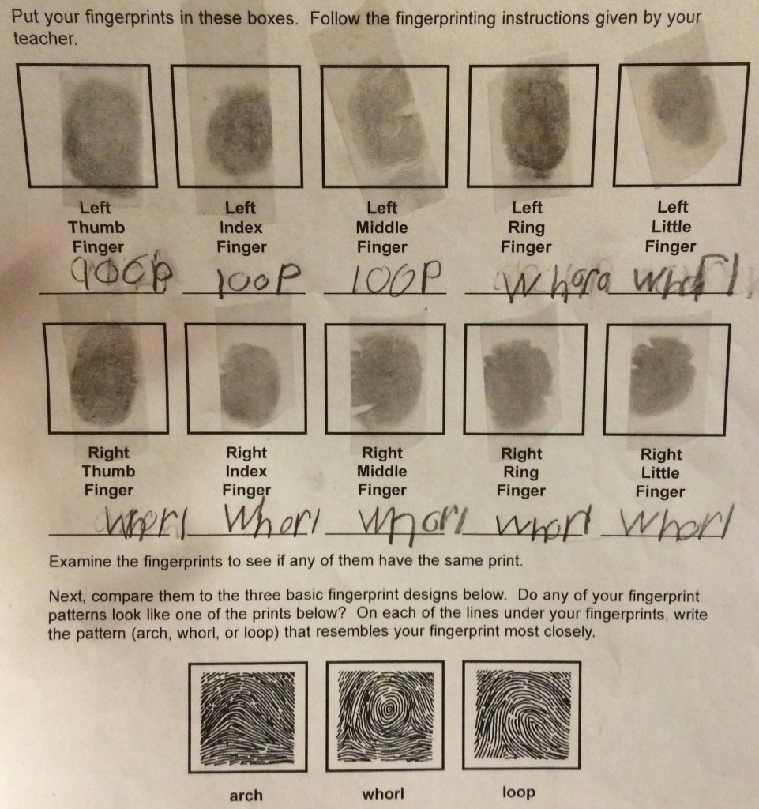
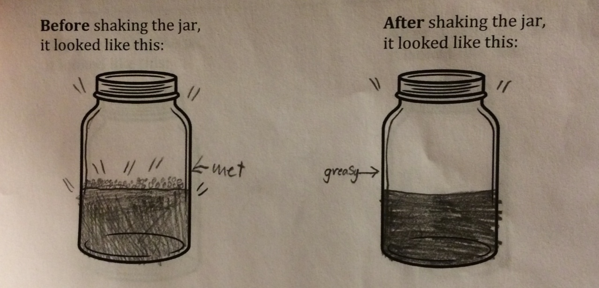
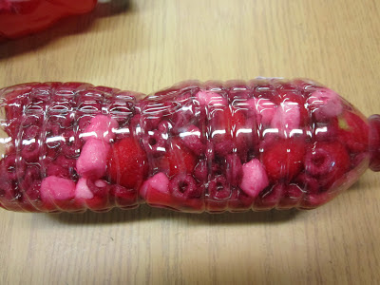
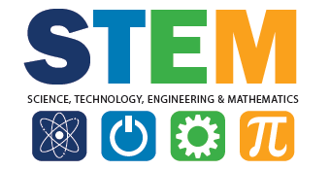
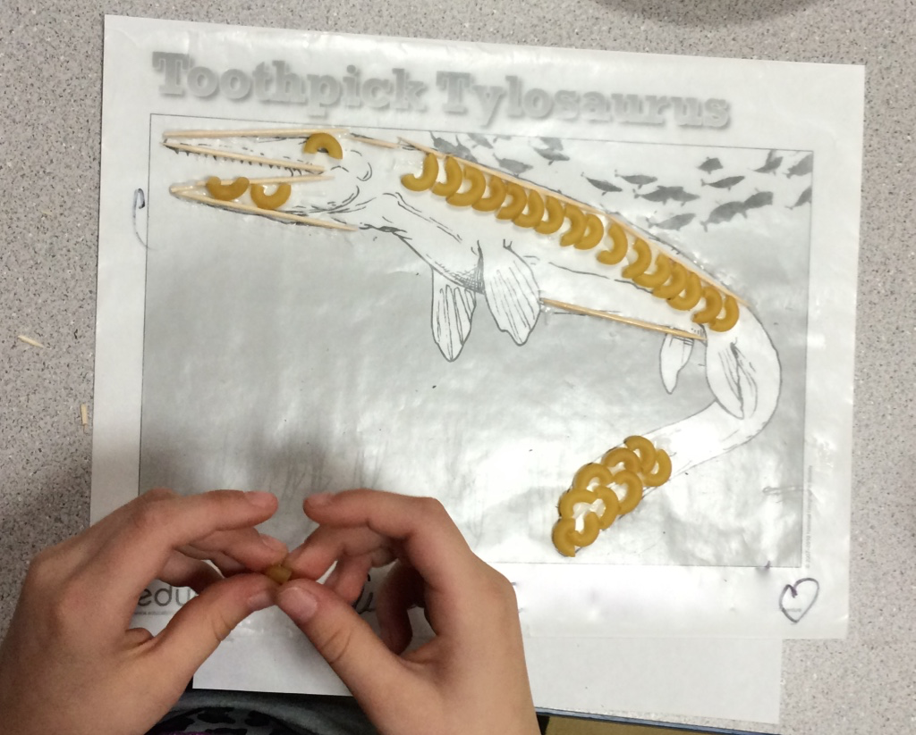
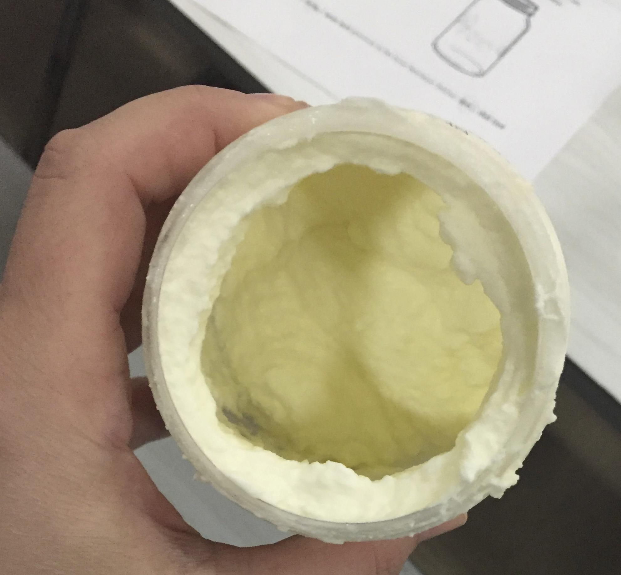
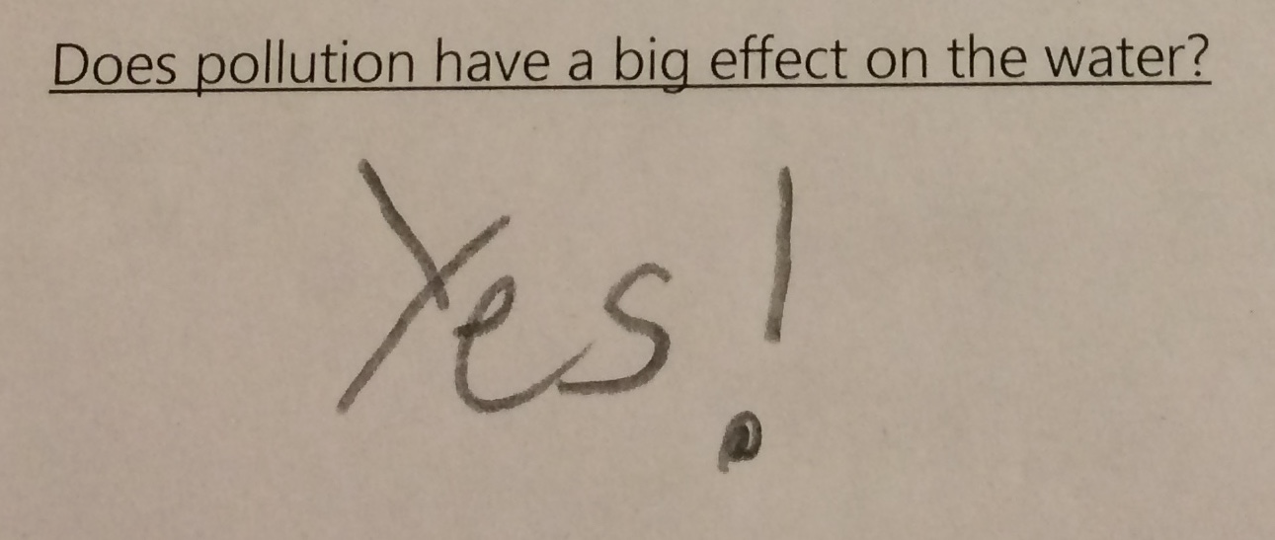
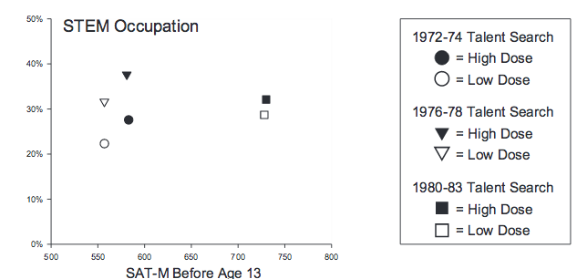
21st Century Program: Science Fun
Brianna Uga¹ & Natalie Peterson¹ (Kim Bellio², Dr. Erin Rehrig¹, sponsor)
1. Dept. of Biology & Chemistry, Fitchburg State University 2. Crocker Elementary School, Fitchburg, MA
The 21st Century grant allowed Crocker Elementary School to develop a before and after-school enrichment program for 2nd-4th grade students.
While participating in the 21st Century Program, we prepared science lessons based on Massachusetts Curriculum Frameworks, fostered positive relationships, and encouraged critical thinking through group discussion, brainstorming, drawing, and hands-on activities.
STEM enrichment is essential for science education and learning.
In today’s schools, STEM-based education is not a main focus. However, the knowledge-base STEM concepts provide, are important factors in student and individual success. Science enrichment activities like the 21st Century Program, provide students with experience incorporating different skills to solve problems resulting in more effective learning than traditional course acceleration (Meyrick, 2011, p. 1). These programs enable students to make real-life connections to content and learning, thus eliminating the age old question of “when will I ever use this information?” in the classroom (Meyrick, 2011).
A study done to explore the connection between precollegiate STEM enrichment and adult achievement documented that increased experience in STEM-based learning corresponded to increased adult STEM-related achievement, directly related to their prior experiences (Wai, et al., 2010).
We inspired students to make connections and gain enthusiasm towards learning and science by creating and implementing a 10-week mini-unit on the use of science in the community. This exposed students to the diverse use of science in everyday life through the discovery of:
Police fingerprinting
Food chain processes
Blood analysis
Butter making & states of matter
Pollution simulation
Animal cold-weather survival
Fossil modeling
pH exploration
Meteorology
Science Fun included weekly, one-hour sessions composed of hands-on experiments, hypothesis formation, activation of prior knowledge through group discussion, diagram creation, and making observations, to explore life science concepts. Students were expected to directly engage in discussions, experiments, and worksheets with 100% completion and accuracy. Throughout activities, students were encouraged to ask questions to gauge comprehension of the concepts.
We regularly reflected upon our lessons. It was essential to adapt activities to student needs, interests, and levels. Often, we provided extra visuals, explanations, and accepted verbal answers instead of writing. Students were eager to participate and always excited to find out what experiment would be next.
The Department of Elementary and Secondary Education awarded Crocker Elementary School of Fitchburg, Massachusetts, a grant to cultivate an exemplary program to enrich knowledge, promote learning, and encourage responsibility within it’s students. This program targets the high population of Low Income, English Language Learners, High Needs, and Students with Disabilities at Crocker Elementary in efforts of counteracting the effects of poverty and isolation that inhibit students ability to succeed academically and socially. Additionally, these students are able to receive exposure to STEM concepts that are not a daily classroom focus.
“I was thrilled to have Natalie and Brianna offer a hands-on science/ STEM experience the students were not getting in class” – Kim Bellio, 21st Century Program Director
The success of the 21st Century Program has been seen through Crocker Elementary School’s raise in ranking from a Level 2 school in 2012 to a Level 1 school in 2013 and 2014. To further maximize the benefit of this program, expansion into further grade levels and schools could be made in the future.
Recording observations about cream and butter
Analyzing our fingerprints
“That is science?! That’s cool!” – Jazmiralez, 3rd grade
Examining blood components through simulation
Creating Tylosaurus fossil models using pasta and toothpicks
“My favorite experiment was making fingerprints!”
– Angel, 3rd grade
Creating solid butter out of liquid cream
Drawing conclusions about pollution
(Wai et al., 2010)
Literature Cited
Meyrick, K. M. (2011). How STEM education improves student learning. Meridian K-12 School Compute Technologies Journal, 14(1), 1-6.
Wai, J., et al. (2010). Accomplishment in science, technology, engineering, and mathematics (STEM) and its relation to STEM educational dose: a 25-year longitudinal study. Journal of Educational Psychology, 102(4), 860-871.
Notes:
Meyrick, K. M. (2011). How STEM education improves student learning. Meridian K-12 School Computer
Technologies Journal, 14(1), 1-6.
Wai, J., et al. (2010). Accomplishment in science, technology, engineering, and mathematics (STEM) and its
relation to STEM educational dose: a 25-year longitudinal study. Journal of Educational
Psychology, 102(4), 860-871.
1

