Slide 1

Virtual EMS
Online Room Reservation Request Tutorial
Creating a Reservation

Slide 2
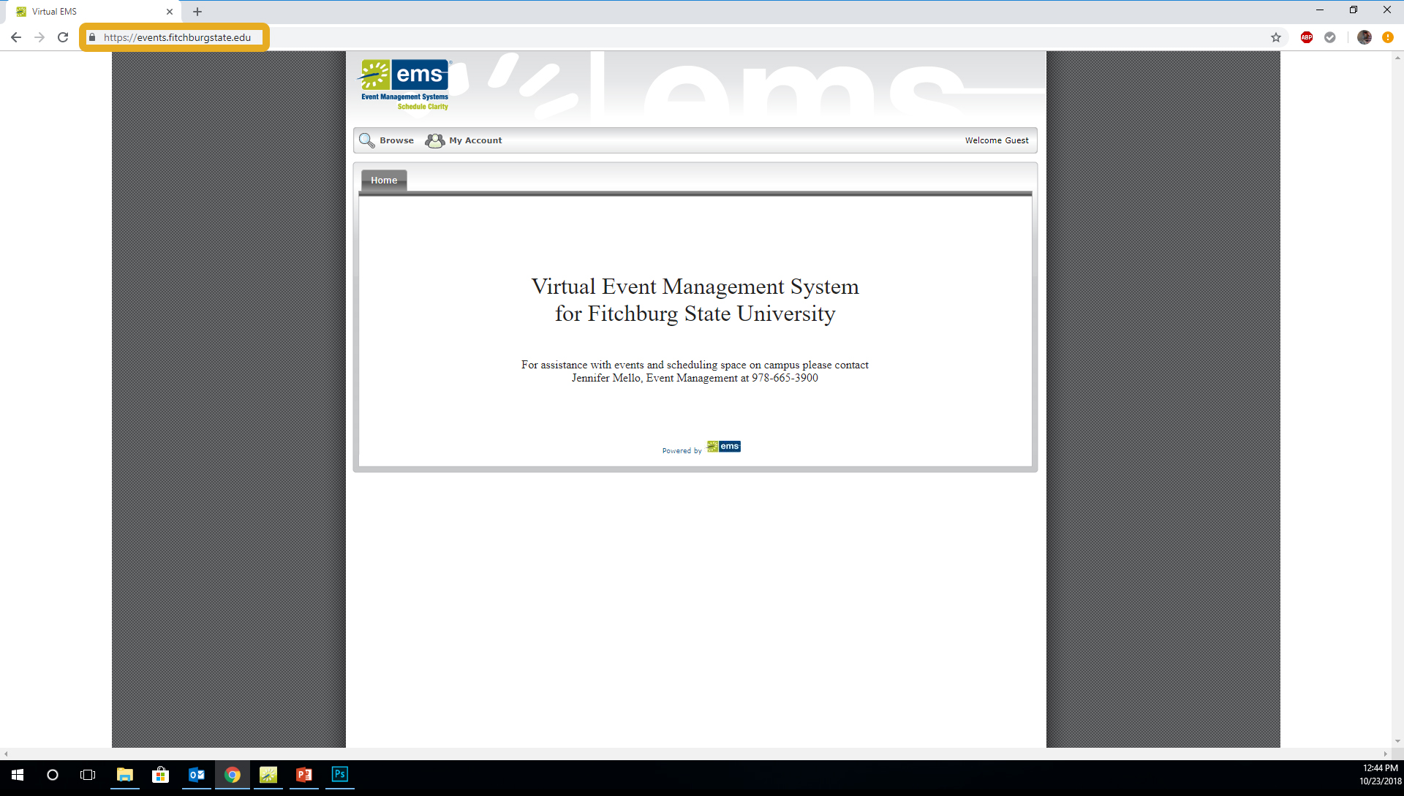
Once you have received your log-in confirmation email from the Office of Event Management, you are ready to book rooms using Virtual EMS.
To do so, first navigate to the Virtual EMS website http://events.fitchburgstate.edu/

Slide 3
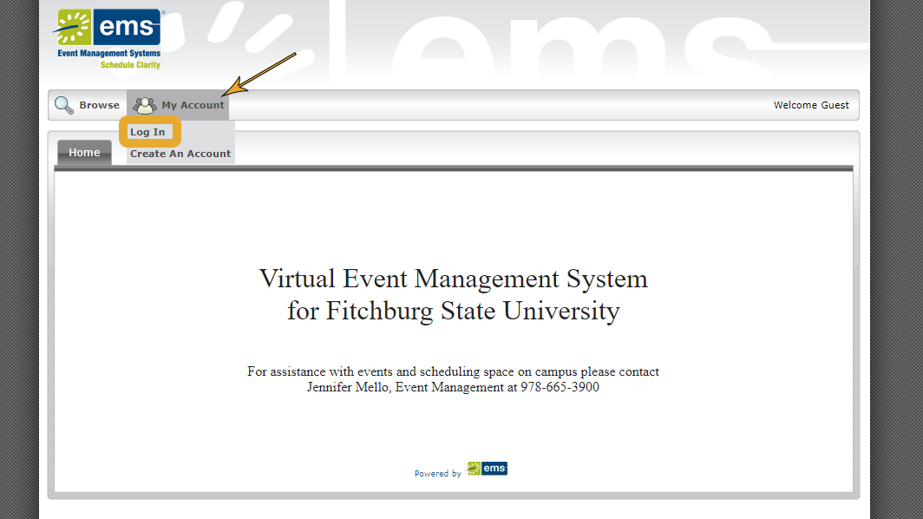
Select Log In under the My Account tab.

Slide 4
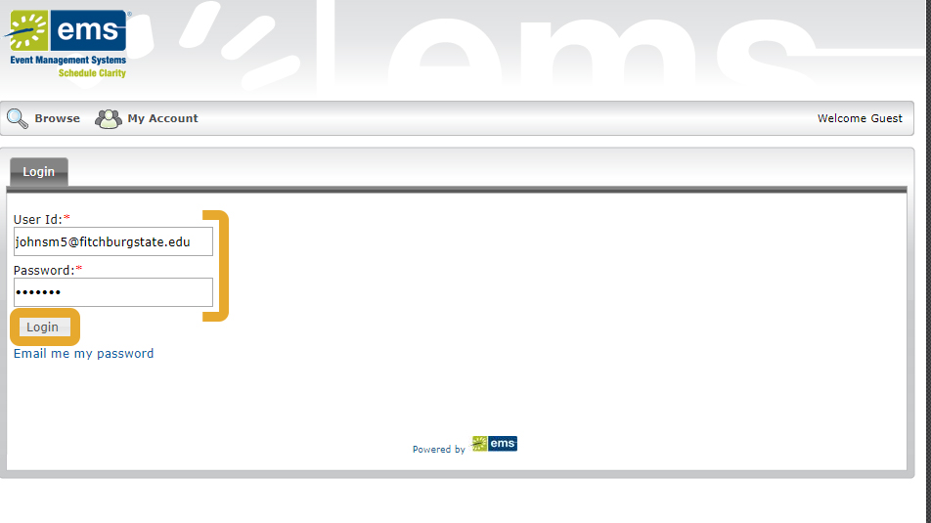
Log In using your credentials.
If at any point you forget your user name and password, call 978-665-3900.

Slide 5
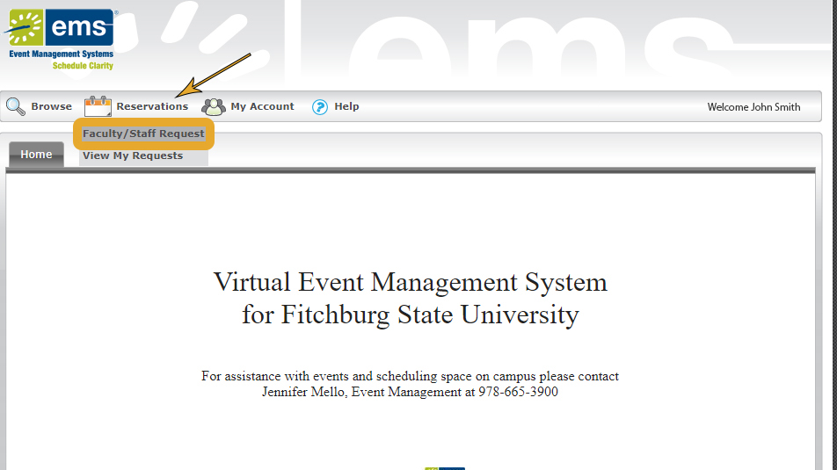
To begin your room request, select Request under the Reservations tab.

Slide 6
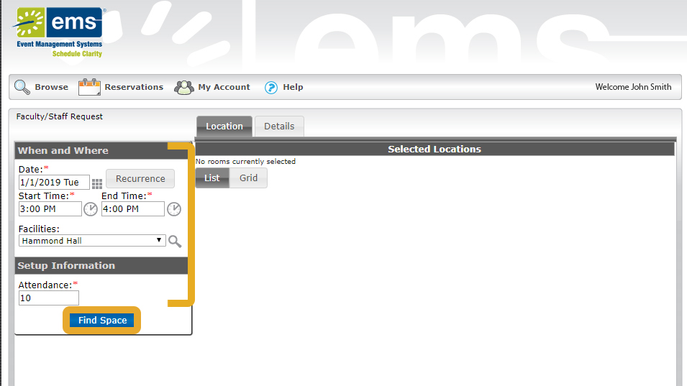
Complete the When and Where for your event as well as an estimated attendance.

Slide 7
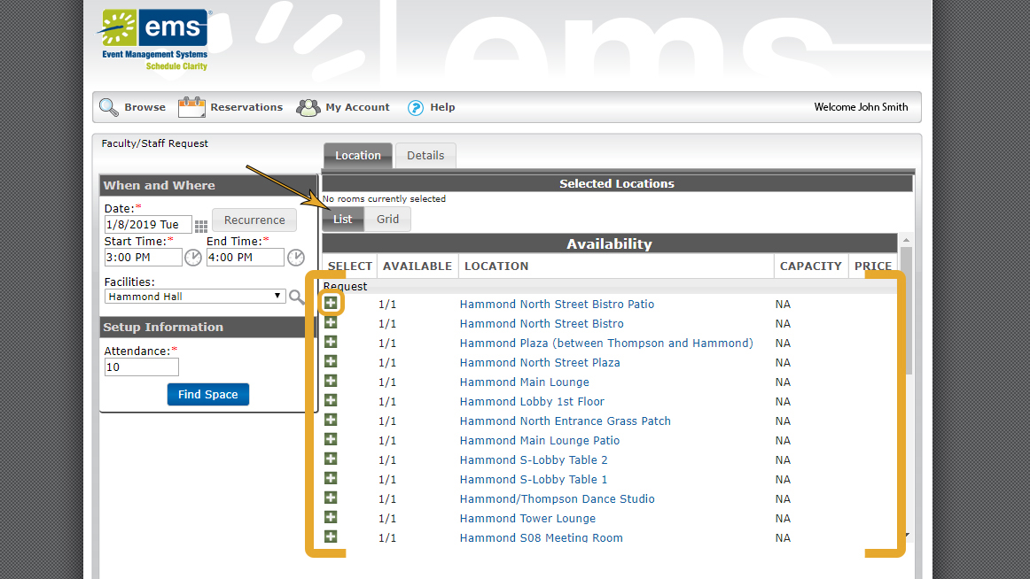
List mode in Virtual EMS presents a list of available spaces for your review.
Click the green plus symbol to select a room to add to your reservation.

Slide 8
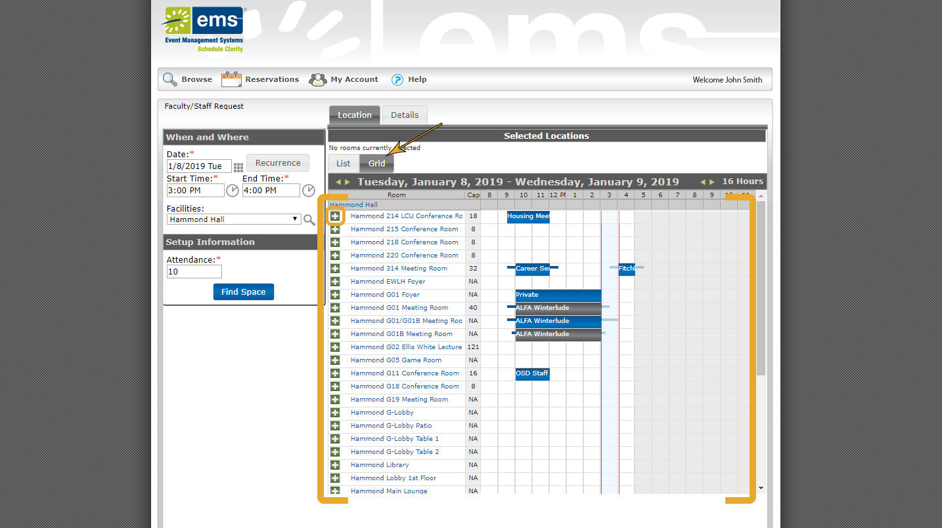
Grid mode is an alternate way to view available rooms.
Click the green plus symbol to select a room to add to your reservation.

Slide 9
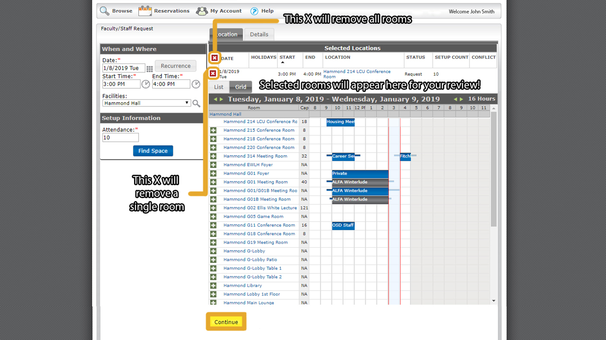
Your selected room(s) are now available for your review.

Slide 10
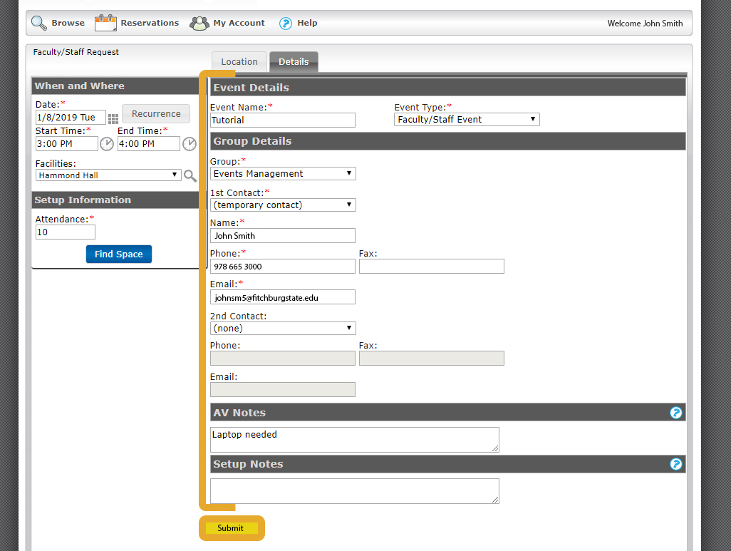
After filling out the details for your event, including set-up & AV needs, hitting submit sends your reservation to the Office of Event Management for final confirmation.

Slide 11
Reservation Confirmation
The Office of Event Management will review your room and service requests. If we have any question or suggestions we will reach out, otherwise you should expect a reservation confirmation within a few days.

Slide 12
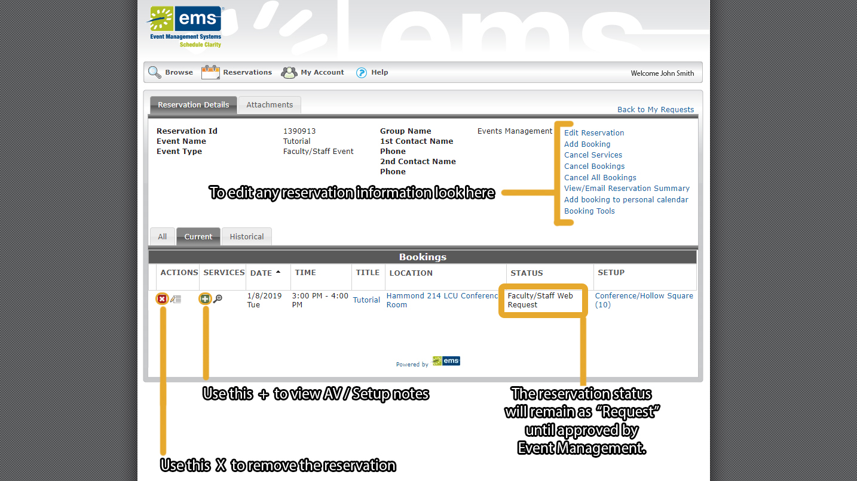
If you would like assistance with editing your reservation, Click Here for an in-depth tutorial!

Slide 13

We are here to assist you
  For questions regarding room reservation and service requests please contact
    Jennifer Mello at 978-665-3900 or jmello9@fitchburgstate.edu
  For questions regarding Virtual EMS or AV support please contact
    Nathan Robichaud at 978-665-3901 or nrobich5@fitchburgstate.edu

